Slide 1
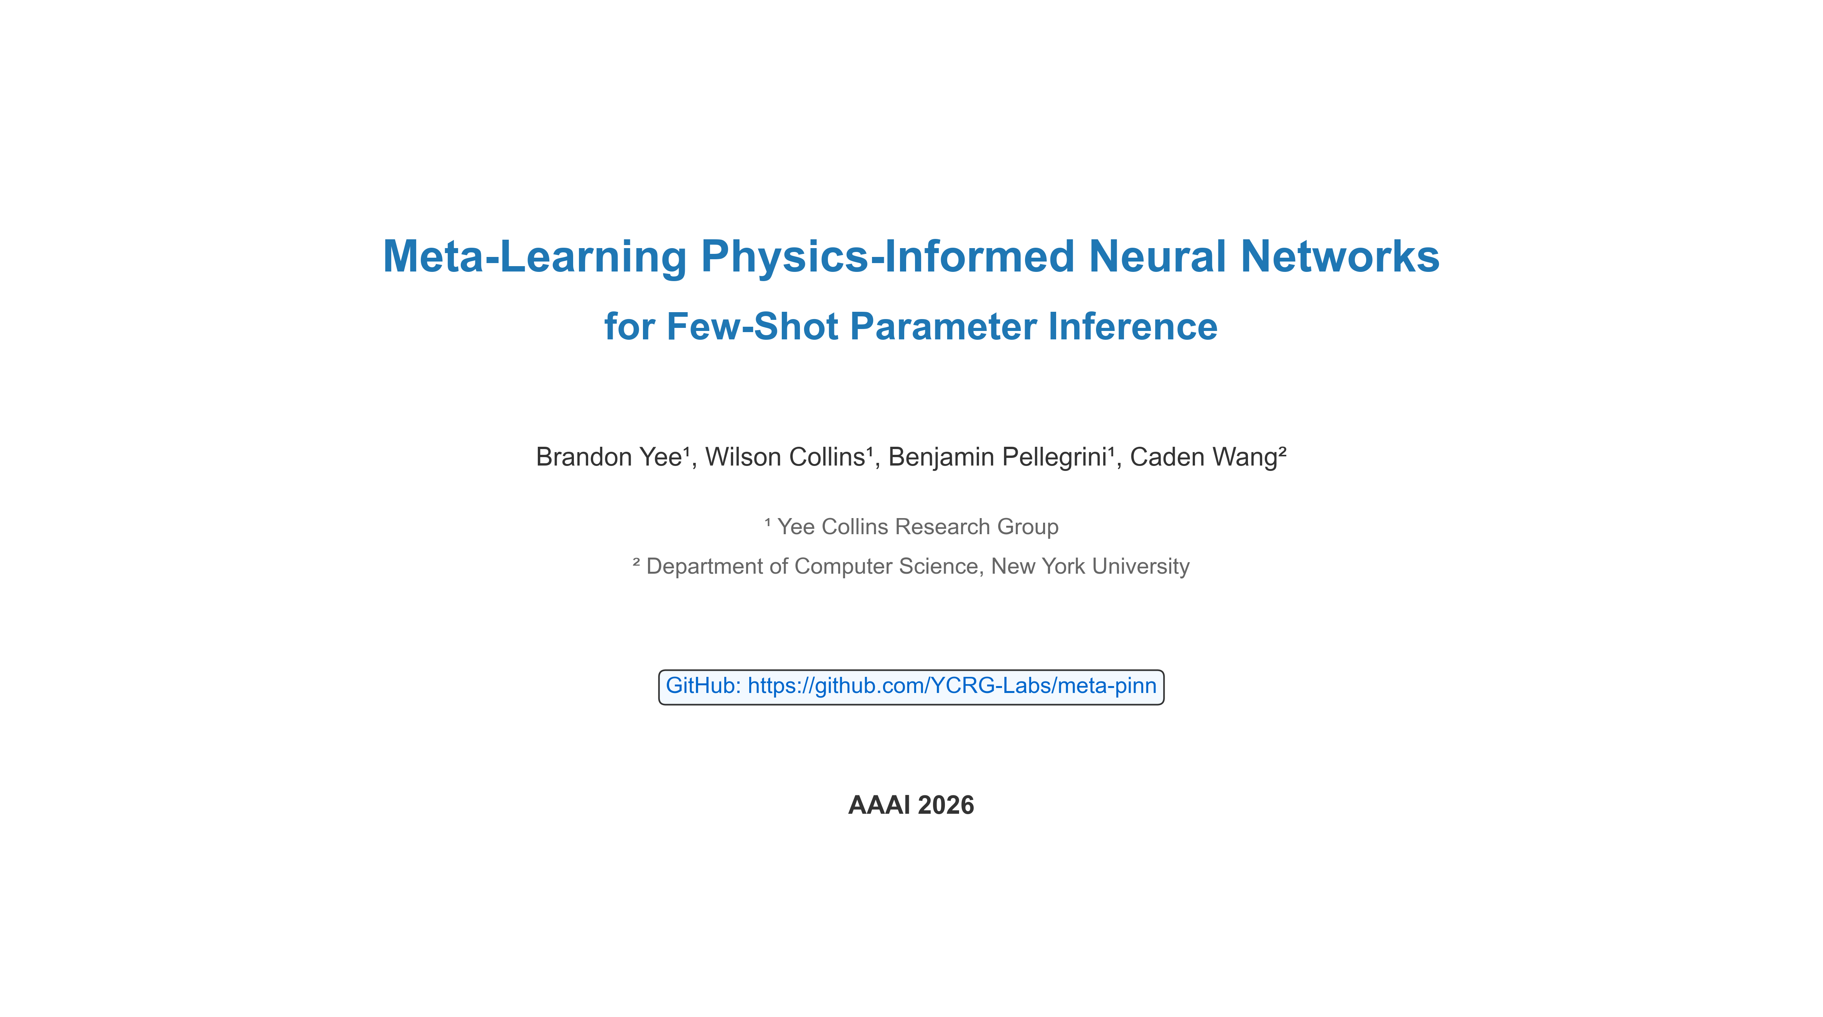
Meta-Learning Physics-Informed Neural Networks for Few-Shot Parameter Inference
Brandon Yee¹, Wilson Collins¹, Benjamin Pellegrini¹, Caden Wang²
¹ Yee Collins Research Group
² Department of Computer Science, New York University
GitHub: https://github.com/YCRG-Labs/meta-pinn
AAAI 2026

Slide 2
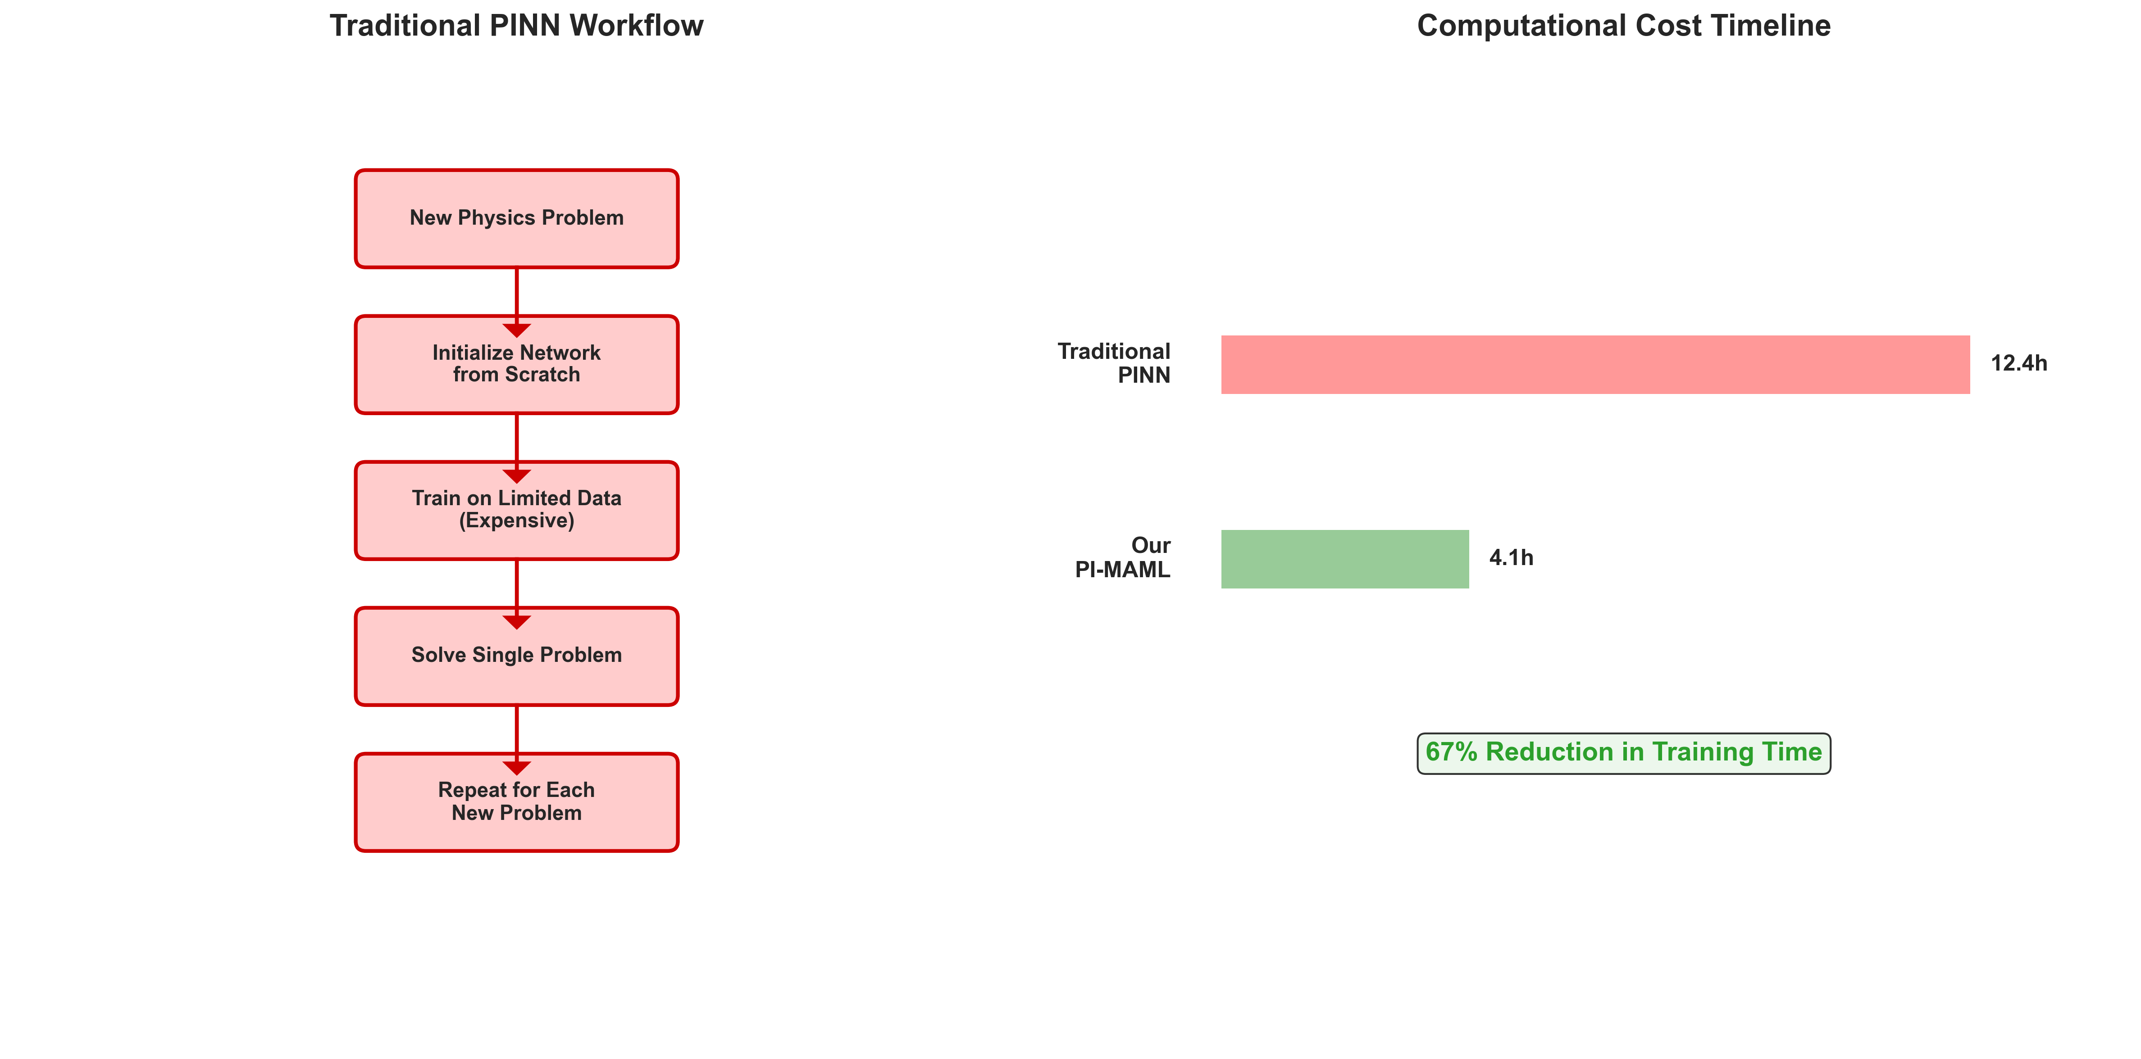
The Core Problem - PINN Limitations
Traditional Physics-Informed Neural Networks Face Critical Limitations:
• Extensive retraining required for each new problem
• No knowledge transfer from previously solved problems
• Poor rapid adaptation to new physical domains
• Inefficient for few-shot scenarios with minimal data
Problem: Each new physics problem treated as completely independent
Impact: Computational bottleneck for real-world applications
Solution Preview: Our approach achieves 67% reduction in training time

Slide 3
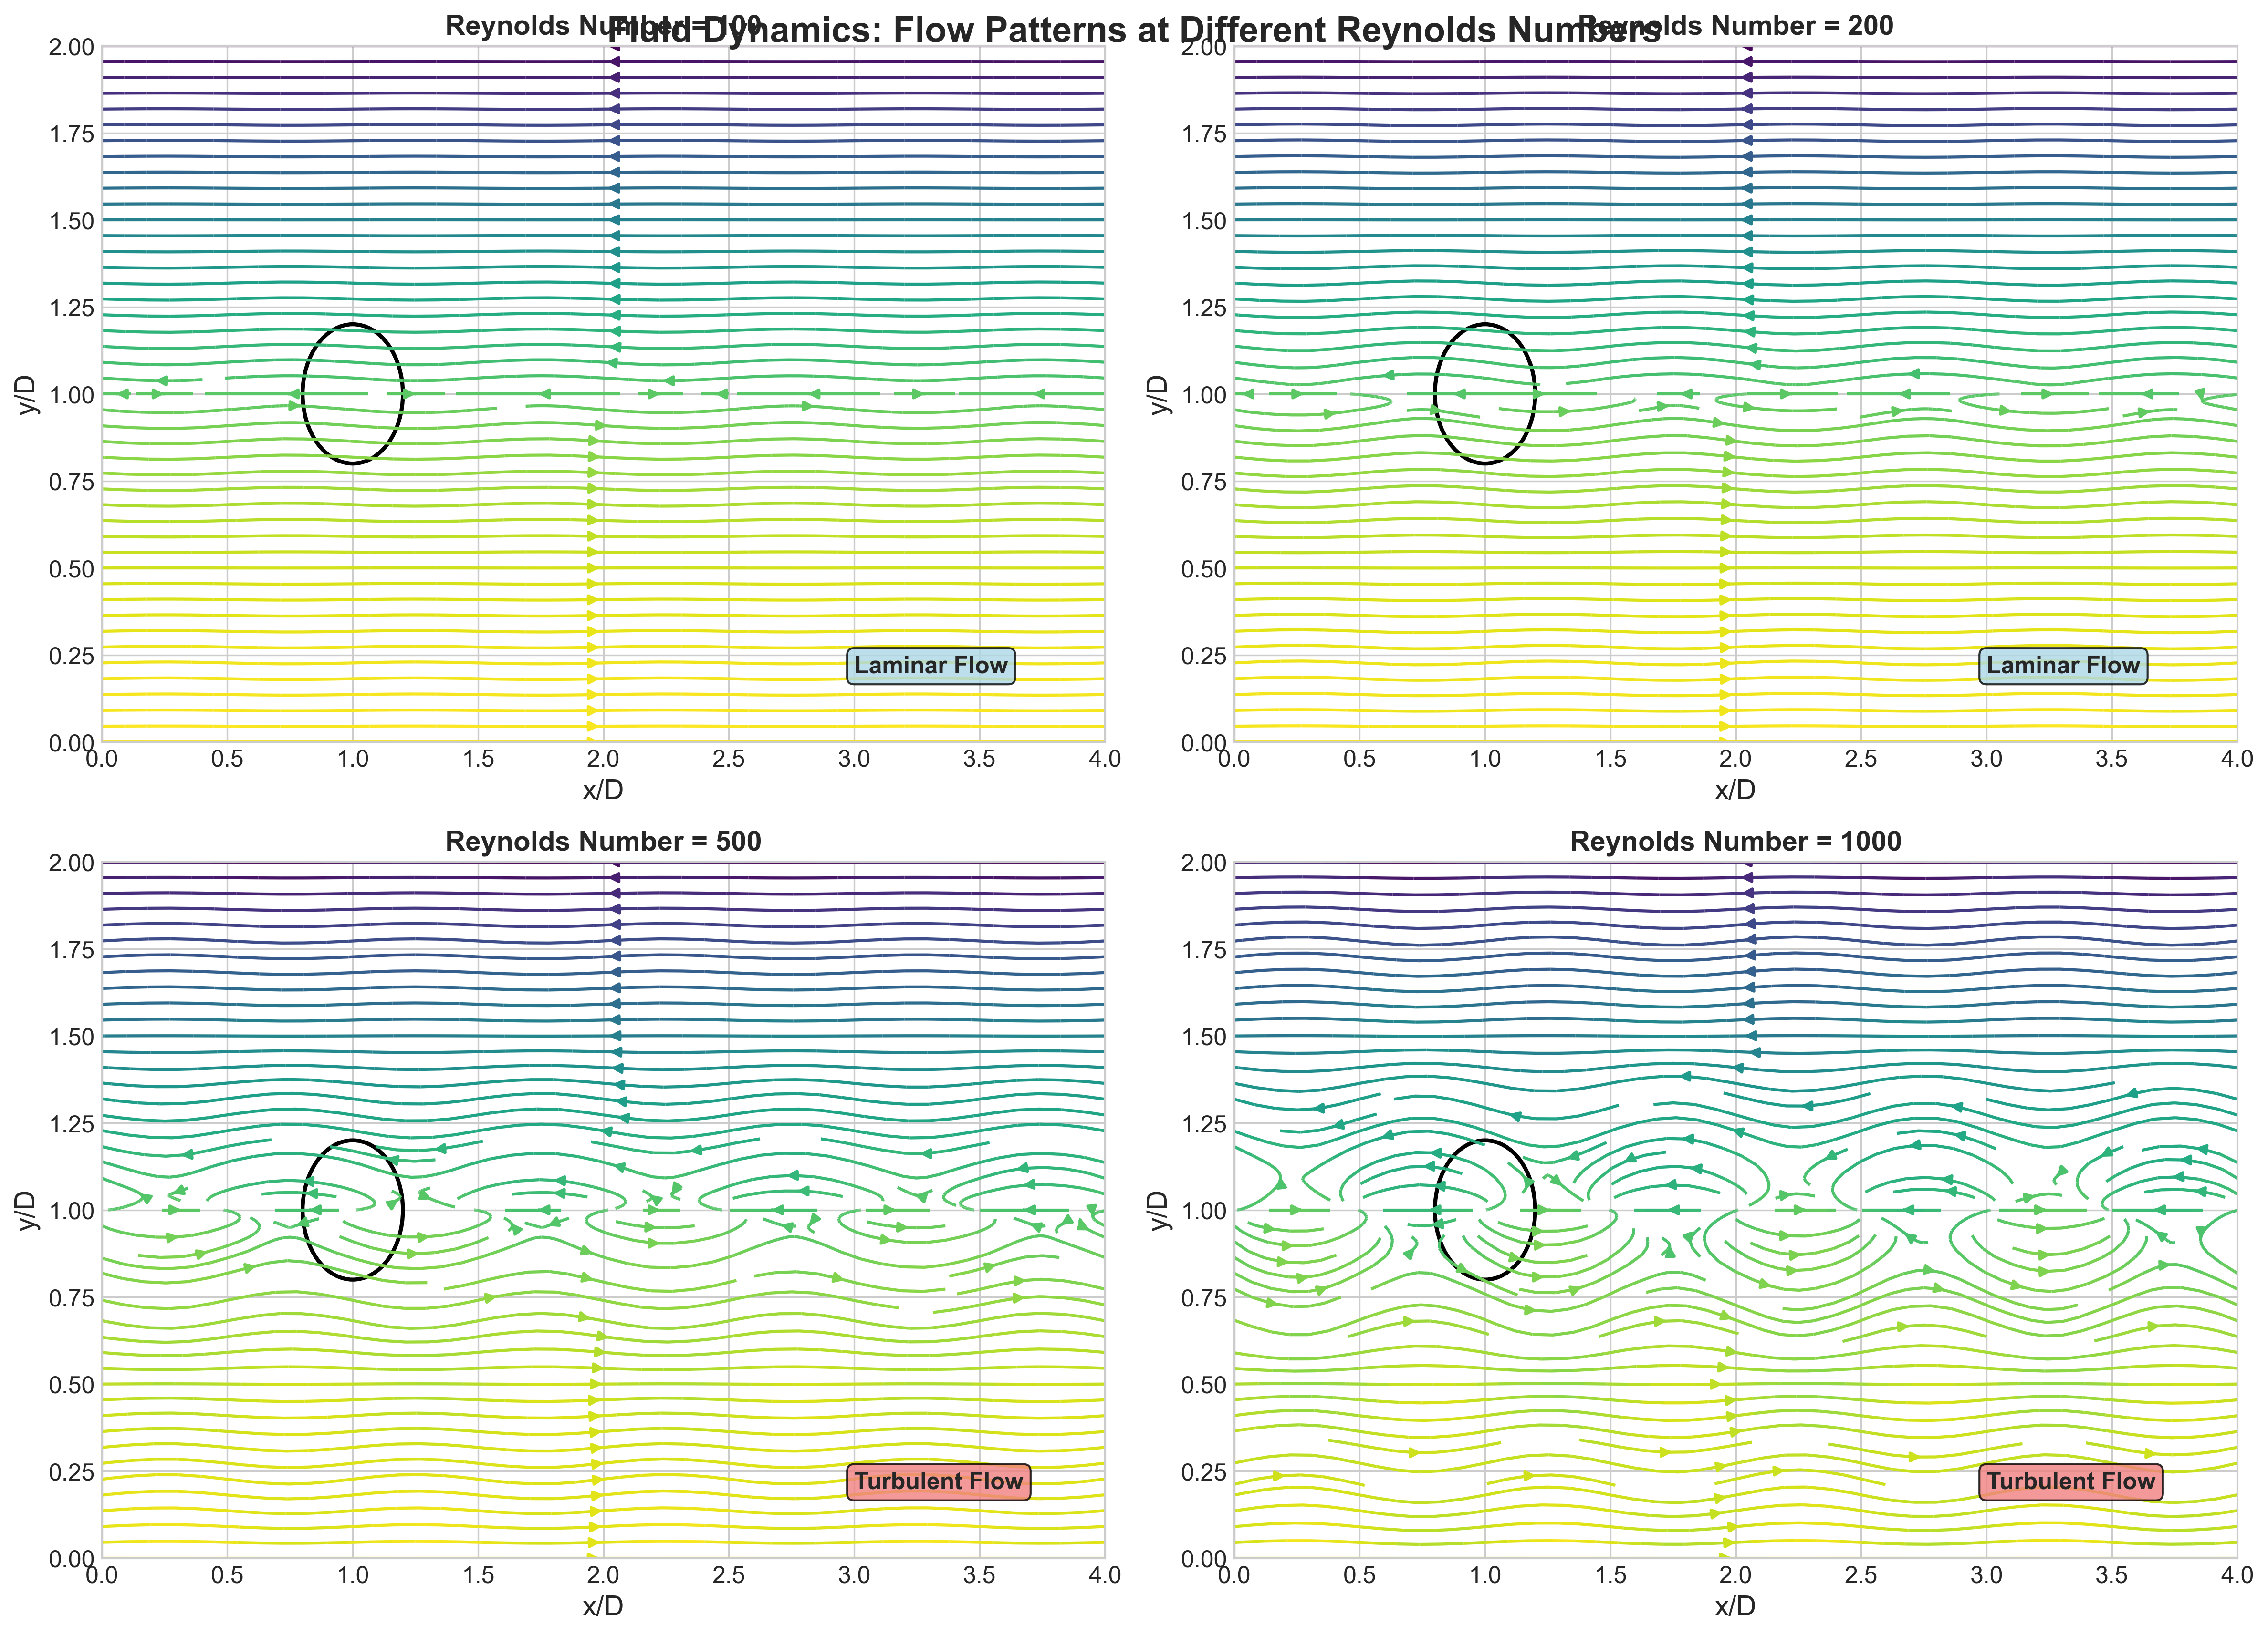
Motivating Example - Fluid Dynamics
Consider Solving Navier-Stokes Equations Across Different Reynolds Numbers:
• Traditional approach: Train separate PINN for Re=100, Re=200, Re=500, Re=1000
• Problem: Each requires full training from scratch (500 steps)
• Inefficiency: No leverage of shared fluid dynamics principles
• Real need: Rapid adaptation to new flow conditions with minimal data
Our Results:
• 67% reduction in training time (12.4h → 4.1h)
• 3× fewer adaptation steps (150 → 50)
• 15% improvement in accuracy

Slide 4
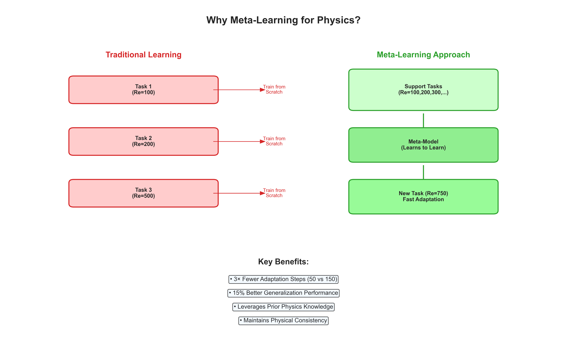
Why Meta-Learning for Physics?
Meta-Learning Offers Promising Solution:
• "Learning to learn" - rapidly adapt to new tasks using prior experience
• Successful in computer vision and natural language processing
• Physics applications remain largely unexplored
• Unique challenges: incorporating physics constraints into meta-learning objectives
Key Benefits Demonstrated:
• 3× Fewer Adaptation Steps (50 vs 150)
• 15% Better Generalization Performance
• Leverages Prior Physics Knowledge
• Maintains Physical Consistency

Slide 5
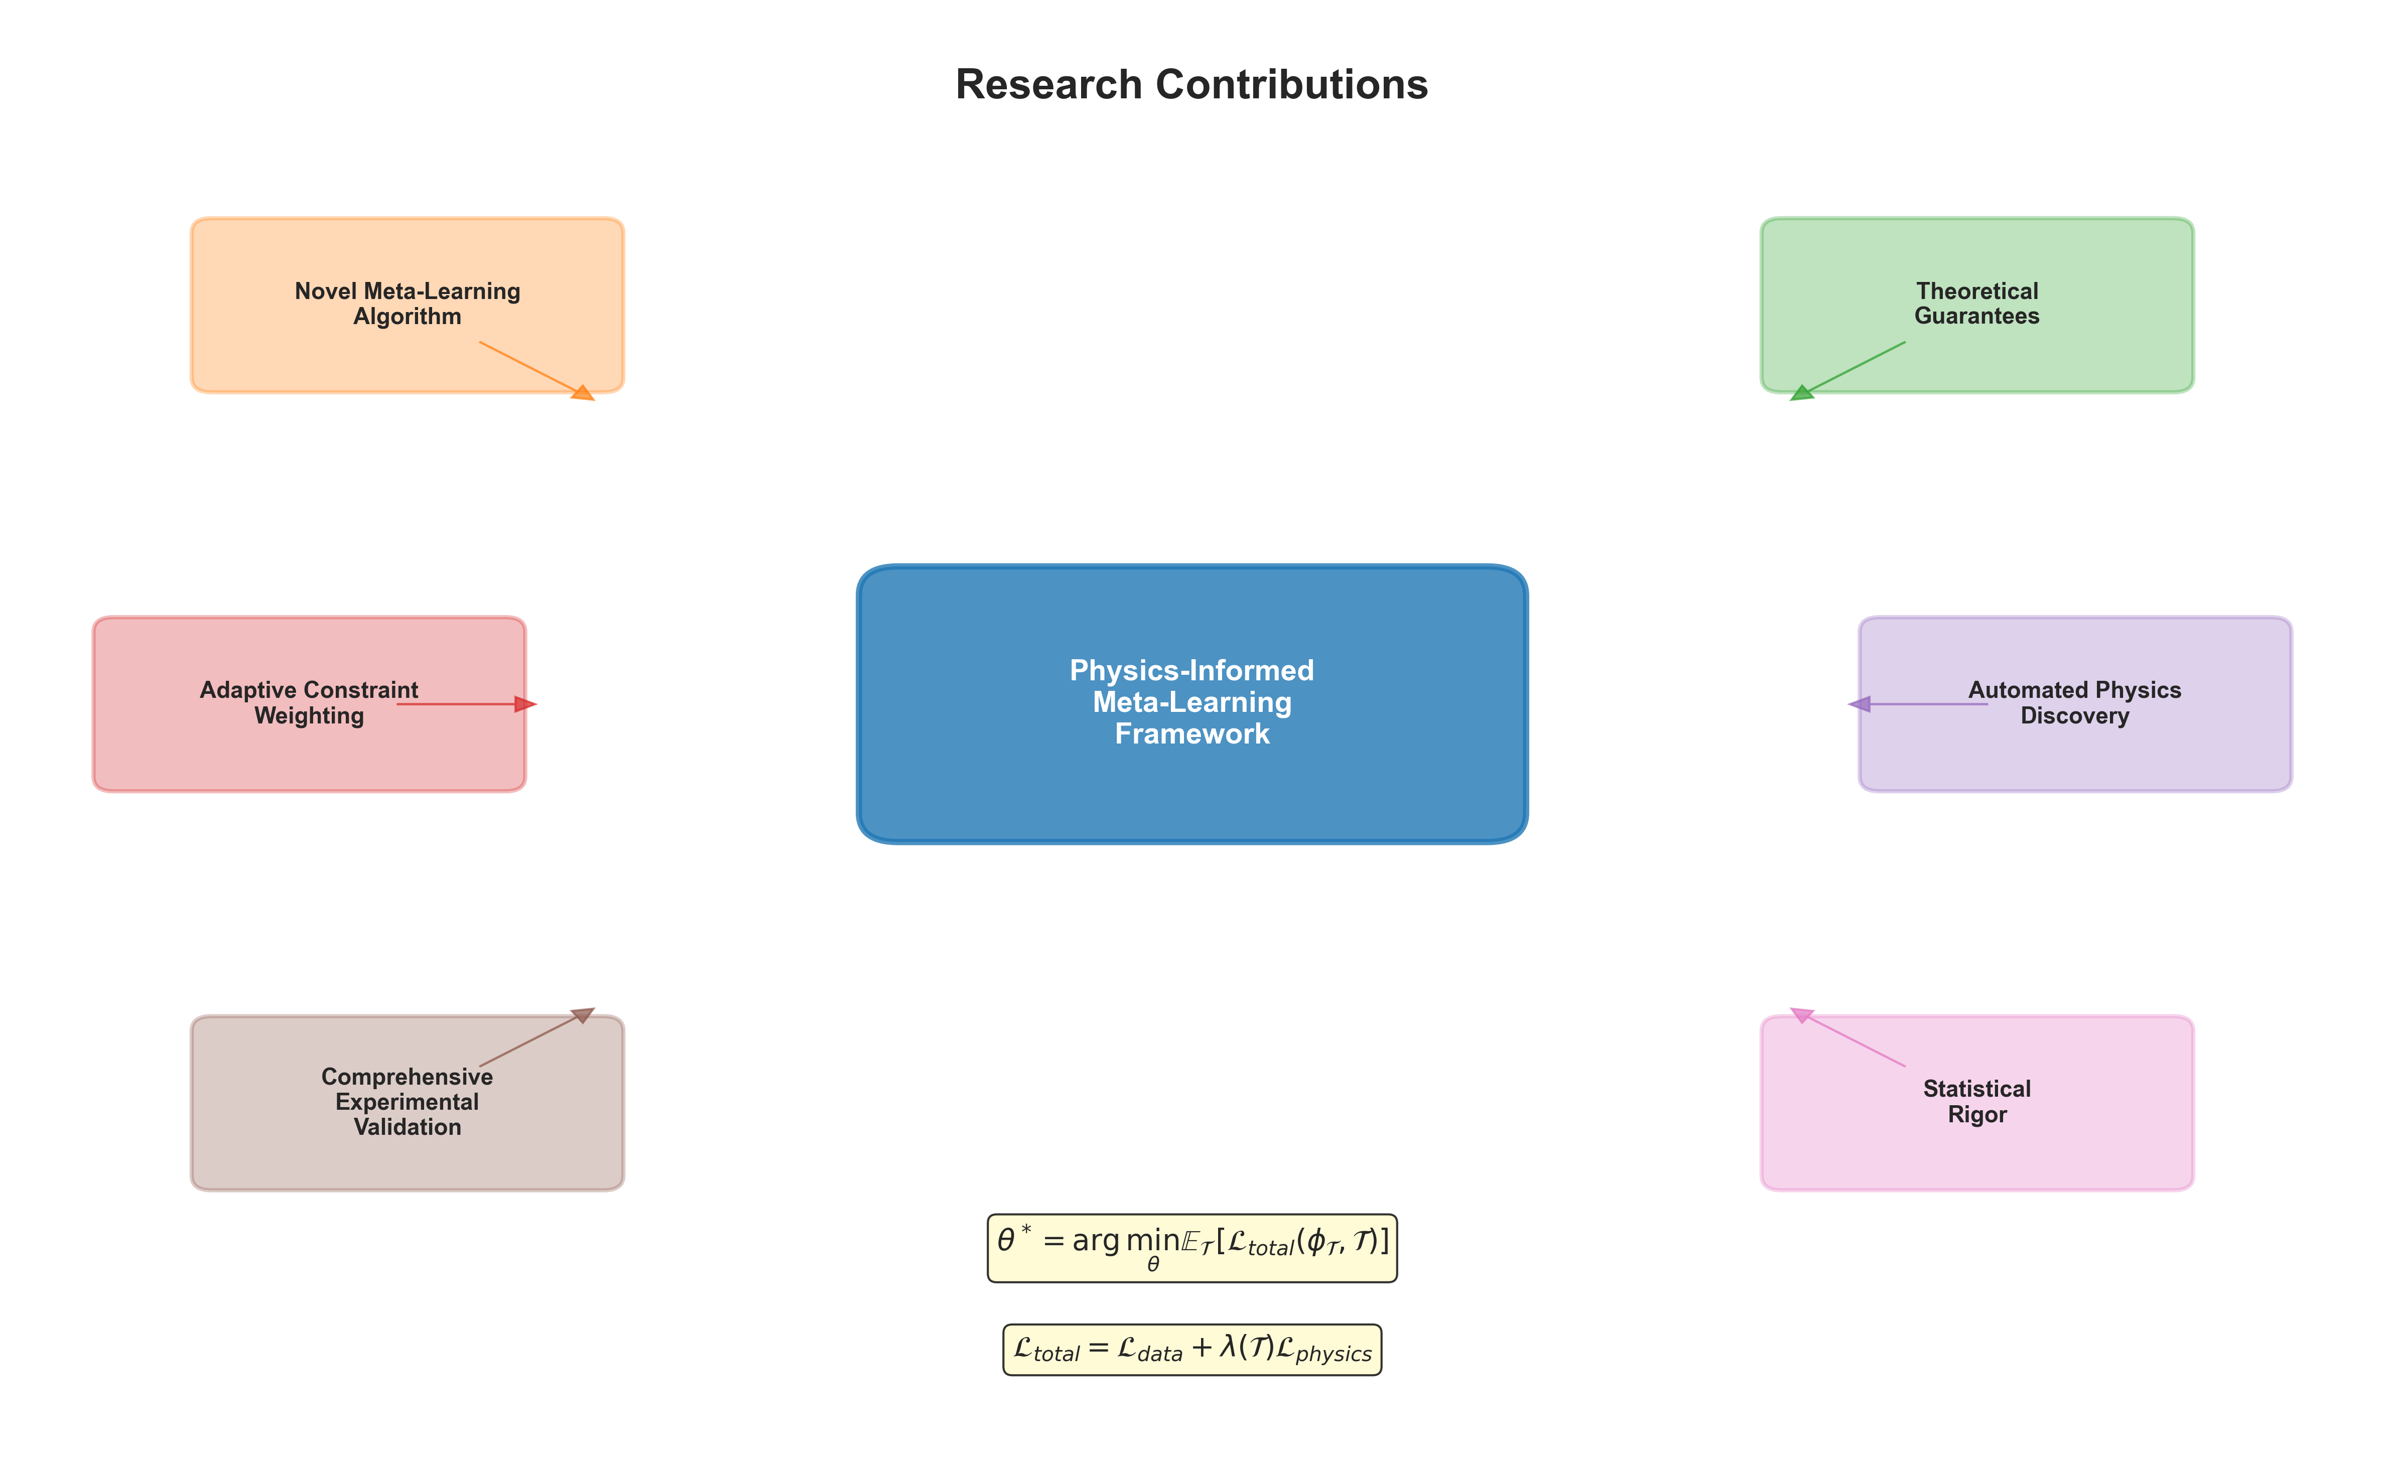
Research Contributions
Our Framework Addresses These Challenges Through:
• Novel meta-learning algorithm incorporating physics constraints in inner and outer loops
• Theoretical convergence guarantees and sample complexity bounds
• Adaptive constraint weighting mechanism for diverse tasks
• Automated physics discovery with natural language interpretation
• Comprehensive experimental validation with rigorous statistical analysis
Mathematical Framework:
θ* = argmin E[L_total(φ_T, T)]
L_total = L_data + λ(T)L_physics

Slide 6
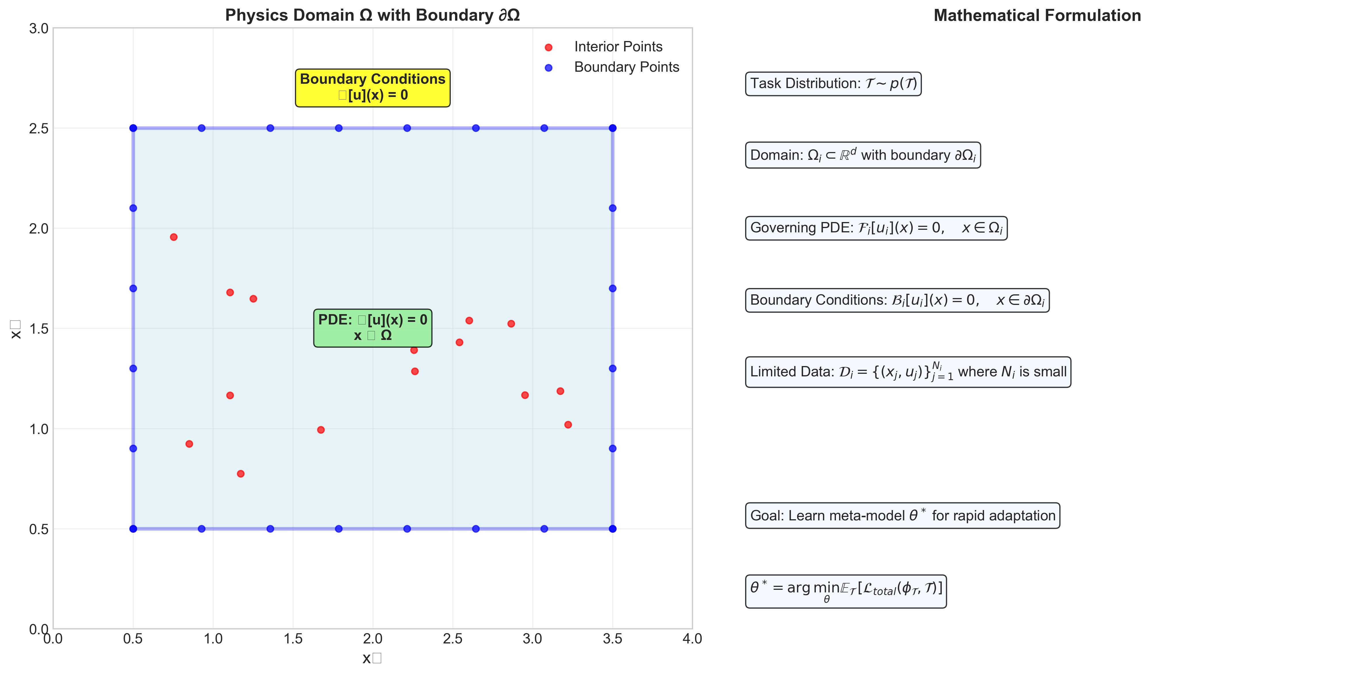
Problem Formulation
Mathematical framework with domain visualization
[Detailed content from presentation outline]

Slide 7
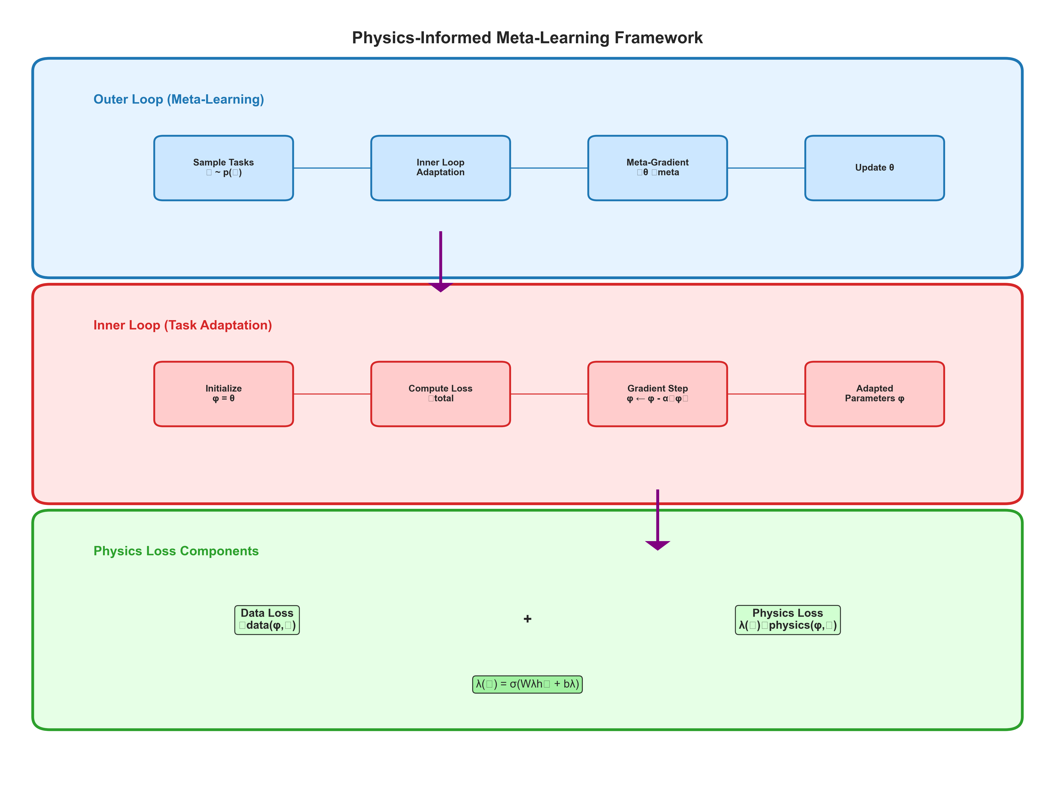
Physics-Informed Meta-Learning Framework
Algorithm flowchart with inner/outer loops
[Detailed content from presentation outline]

Slide 8
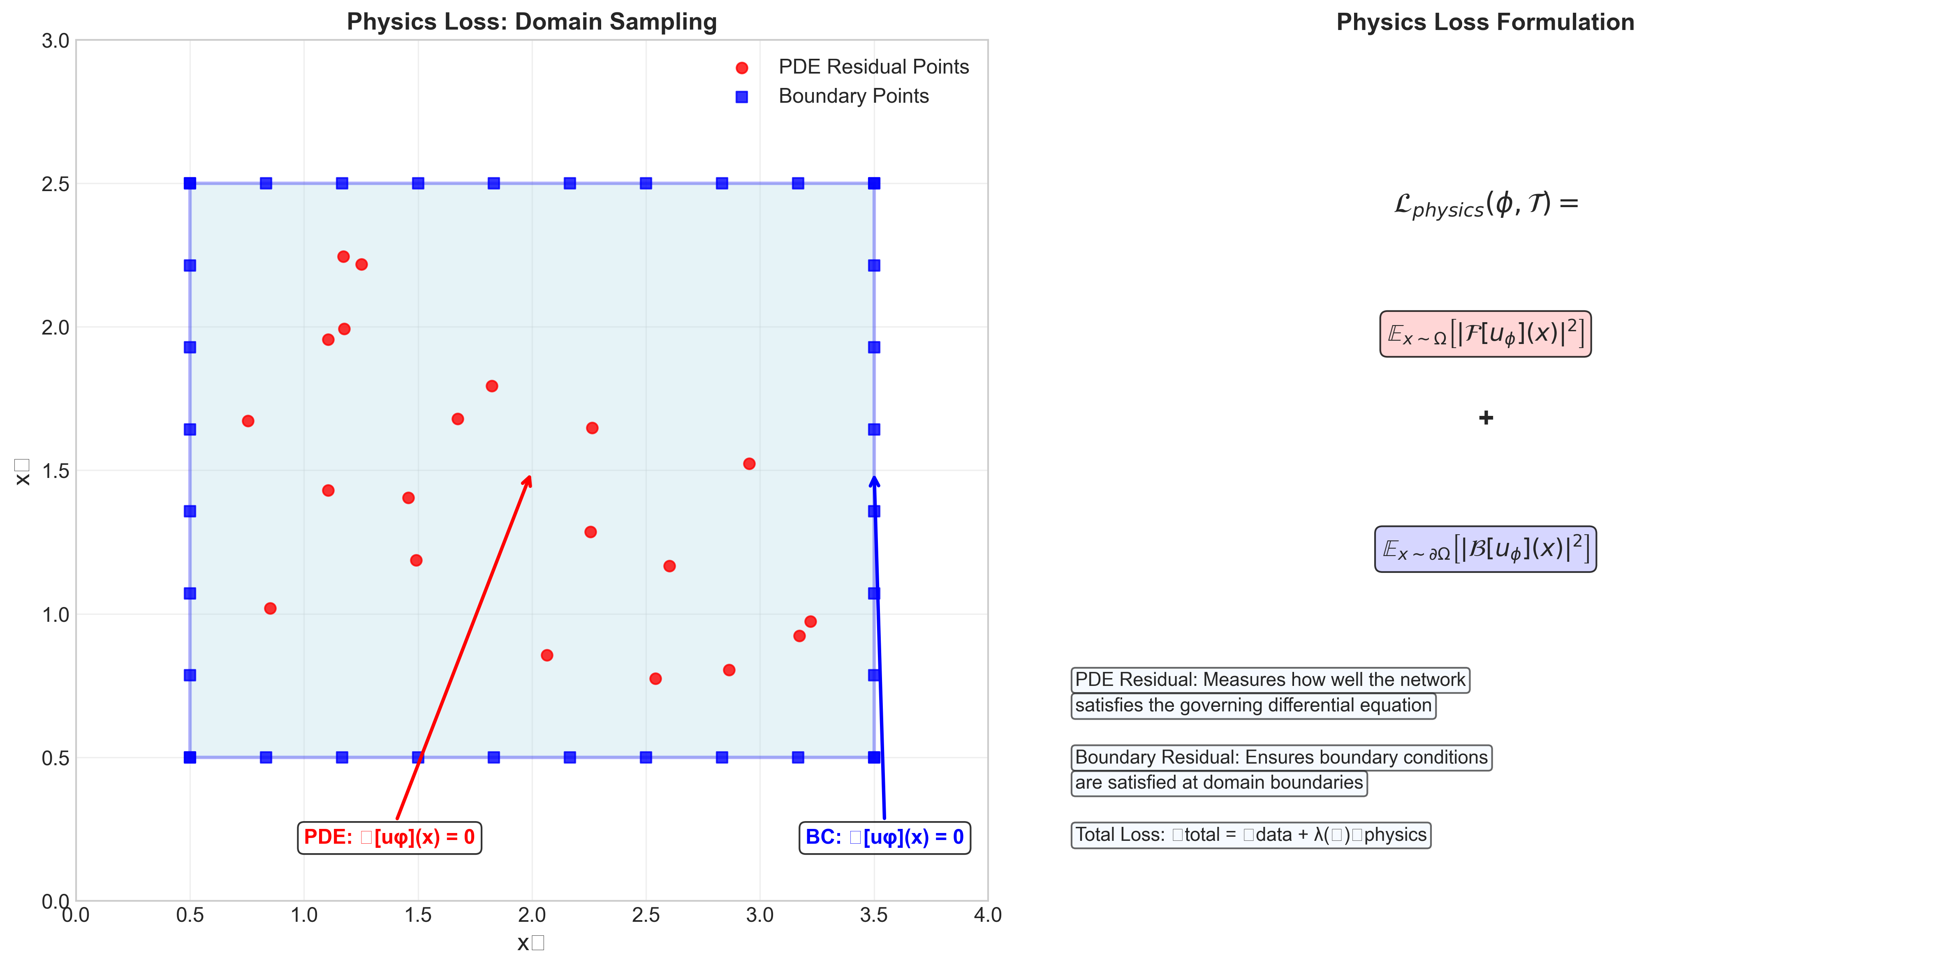
Physics Loss Implementation
PDE constraint enforcement
[Detailed content from presentation outline]

Slide 9
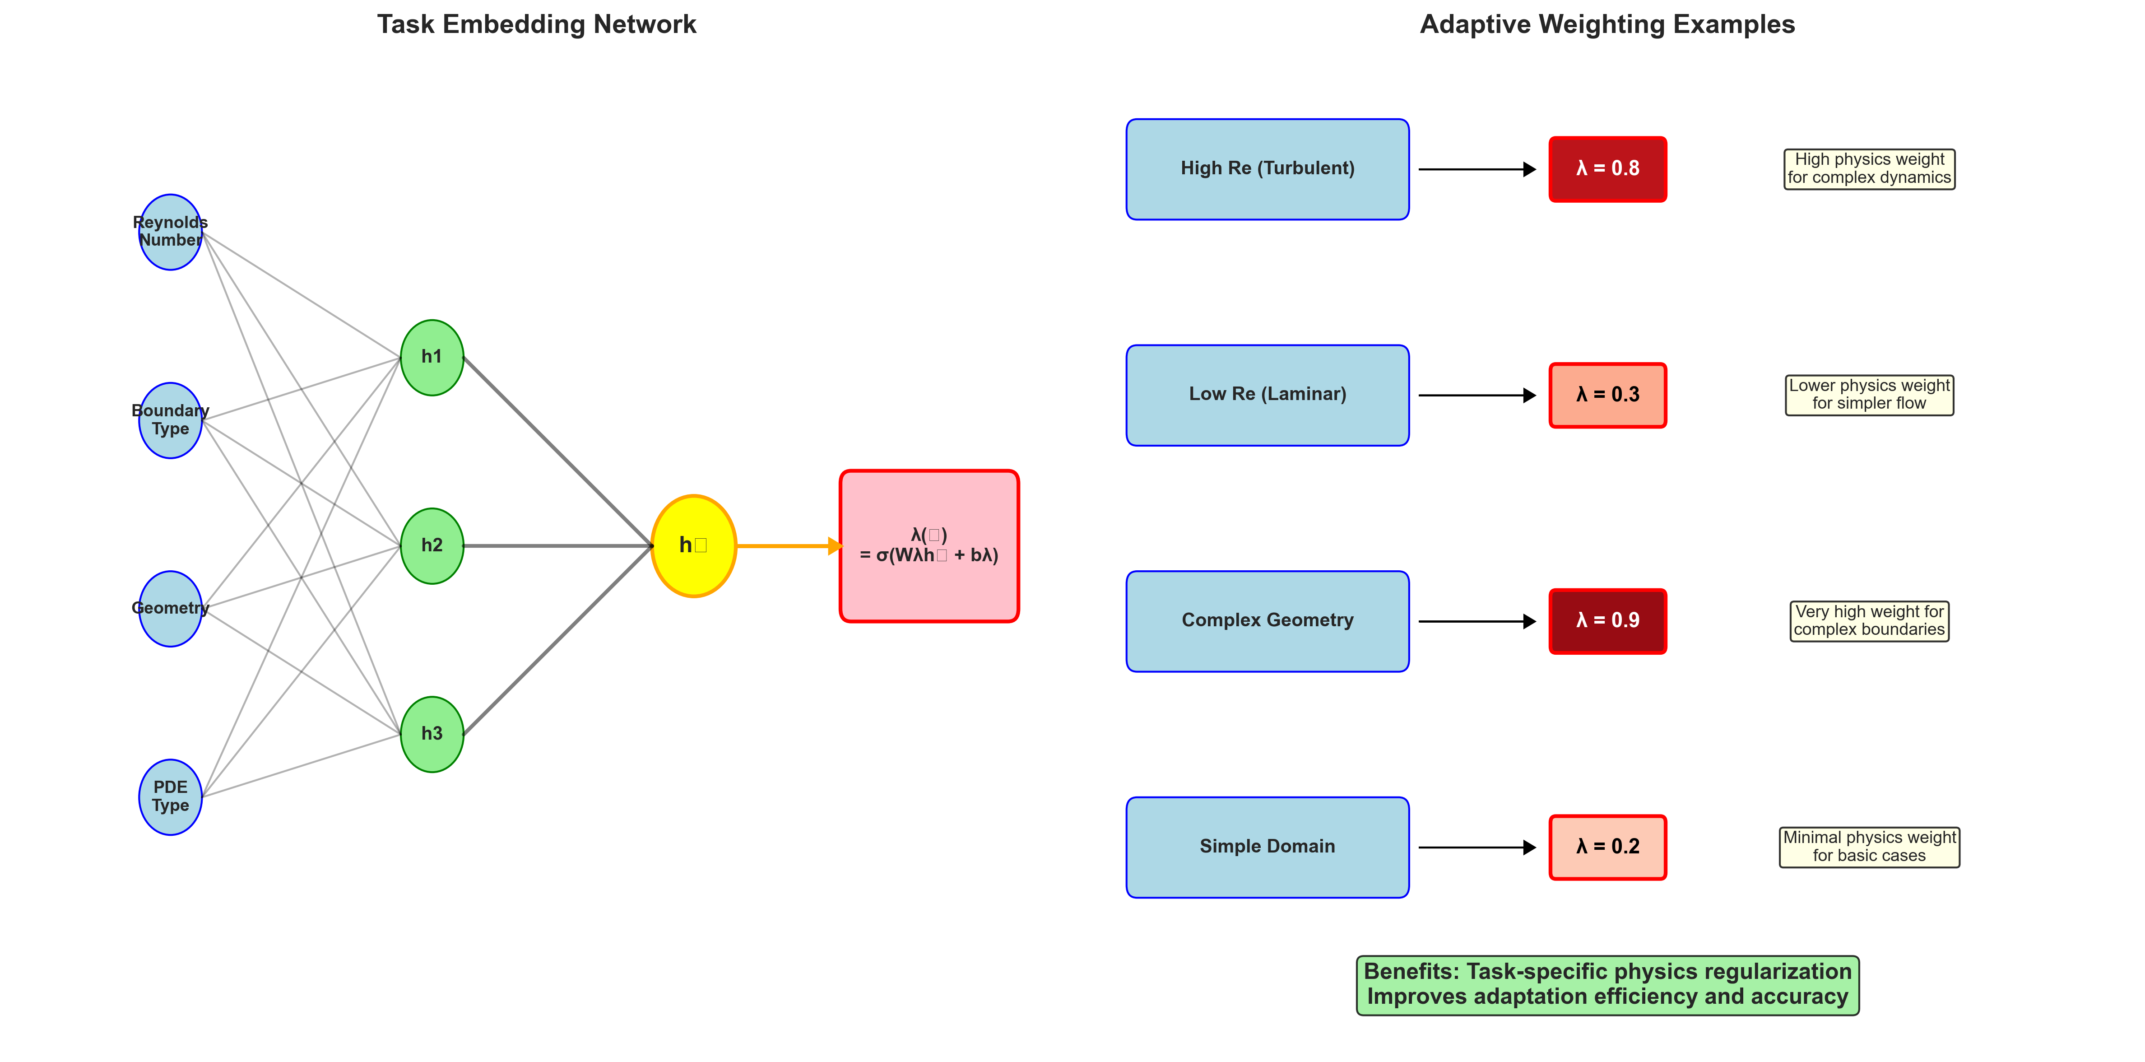
Adaptive Constraint Weighting
Task-specific physics importance
[Detailed content from presentation outline]

Slide 10
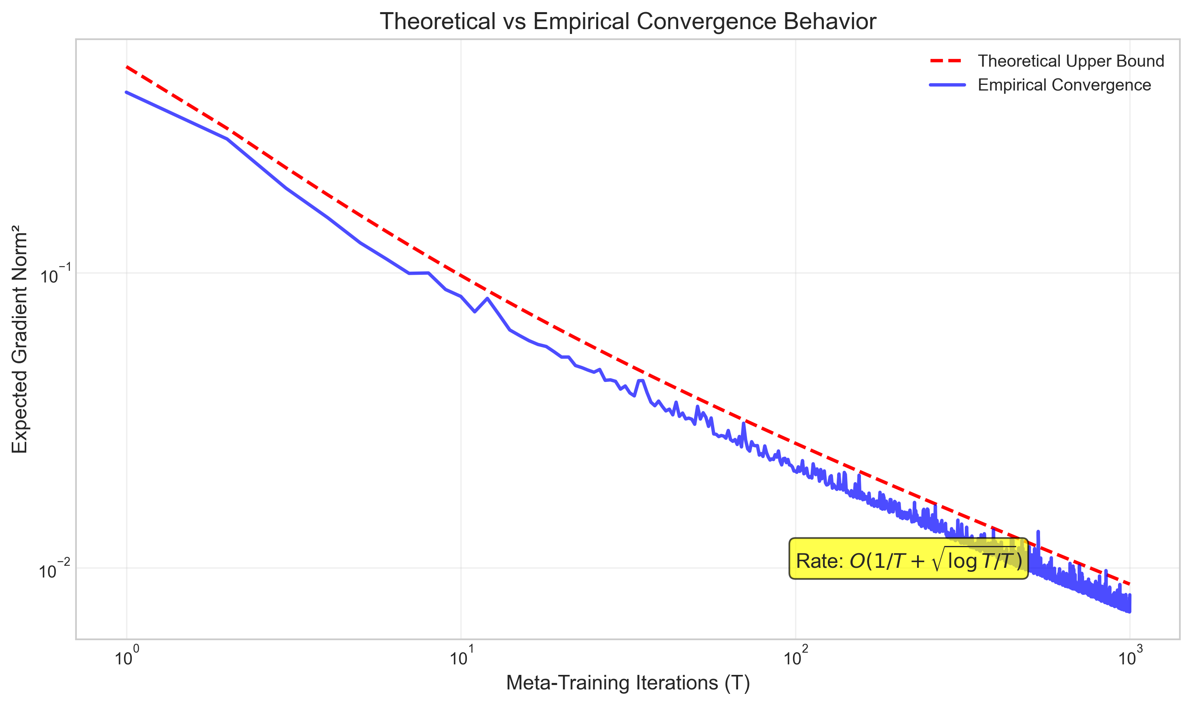
Theoretical Convergence Guarantees
Mathematical analysis and convergence rates
[Detailed content from presentation outline]

Slide 11
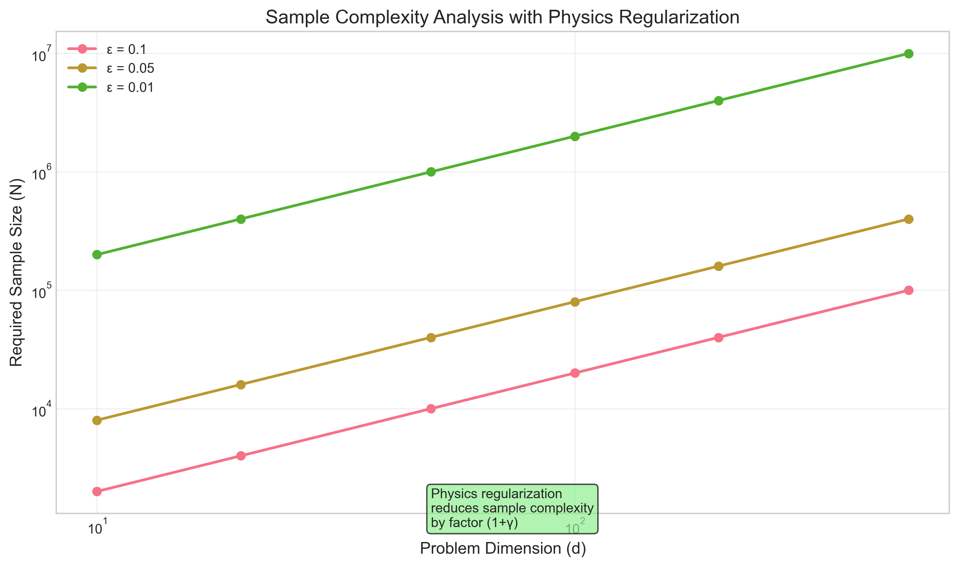
Sample Complexity Analysis
Physics regularization benefits
[Detailed content from presentation outline]

Slide 12
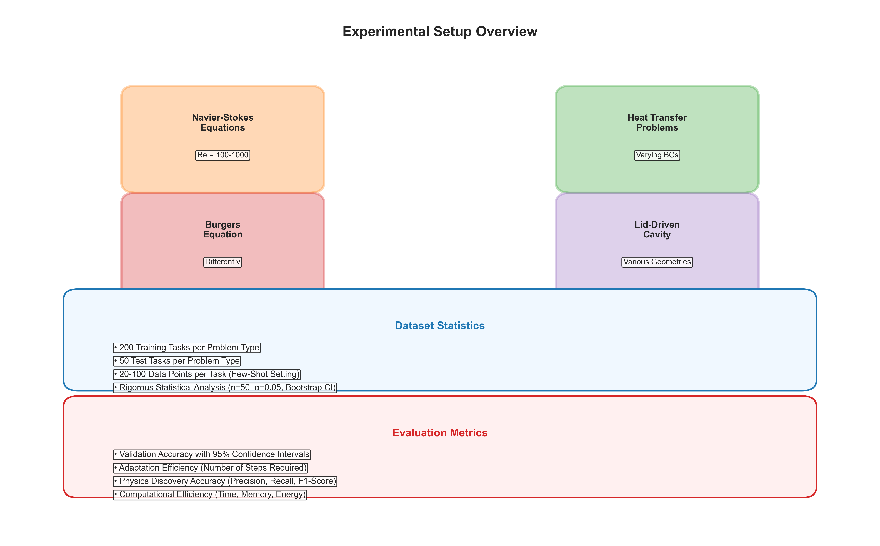
Experimental Setup Overview
Comprehensive fluid dynamics evaluation
[Detailed content from presentation outline]

Slide 13
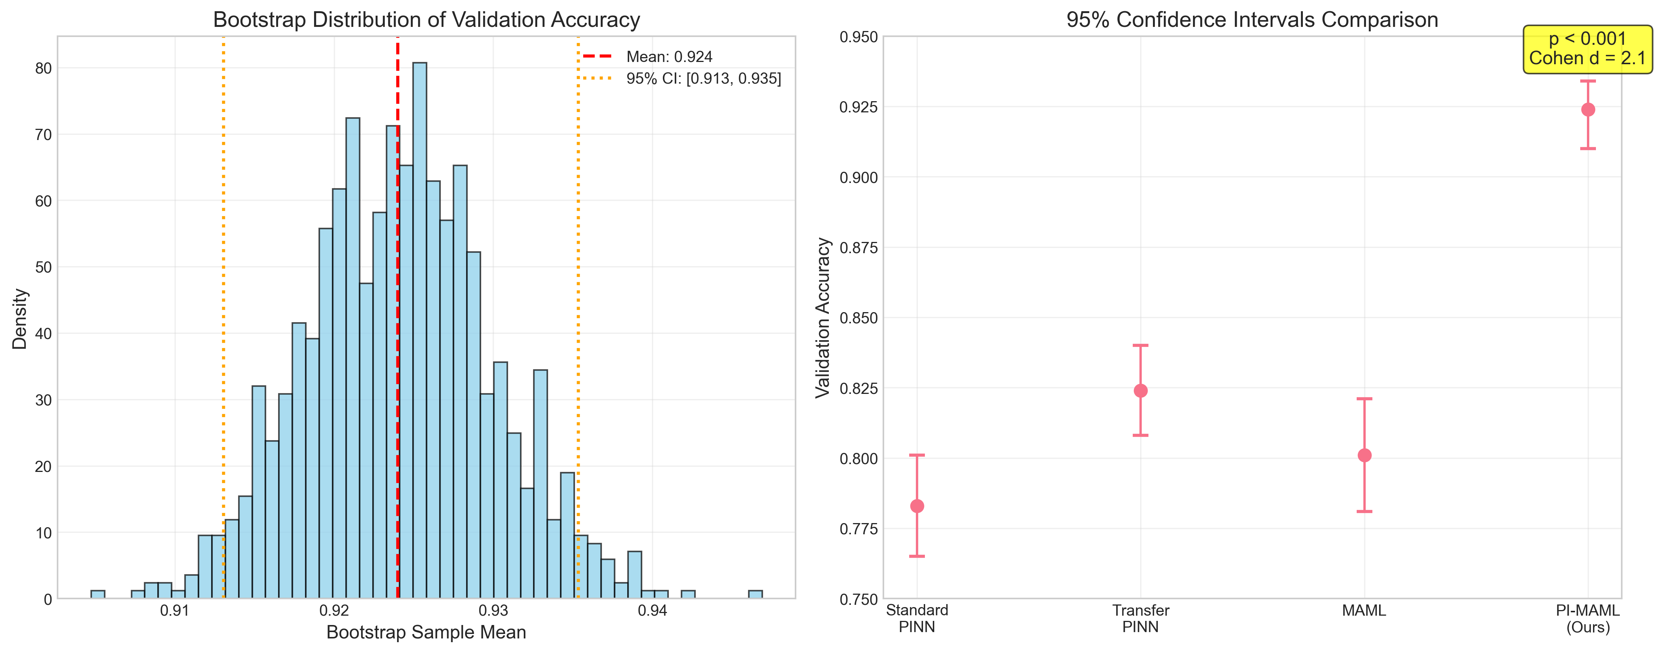
Statistical Analysis Methodology
Rigorous statistical validation
[Detailed content from presentation outline]

Slide 14
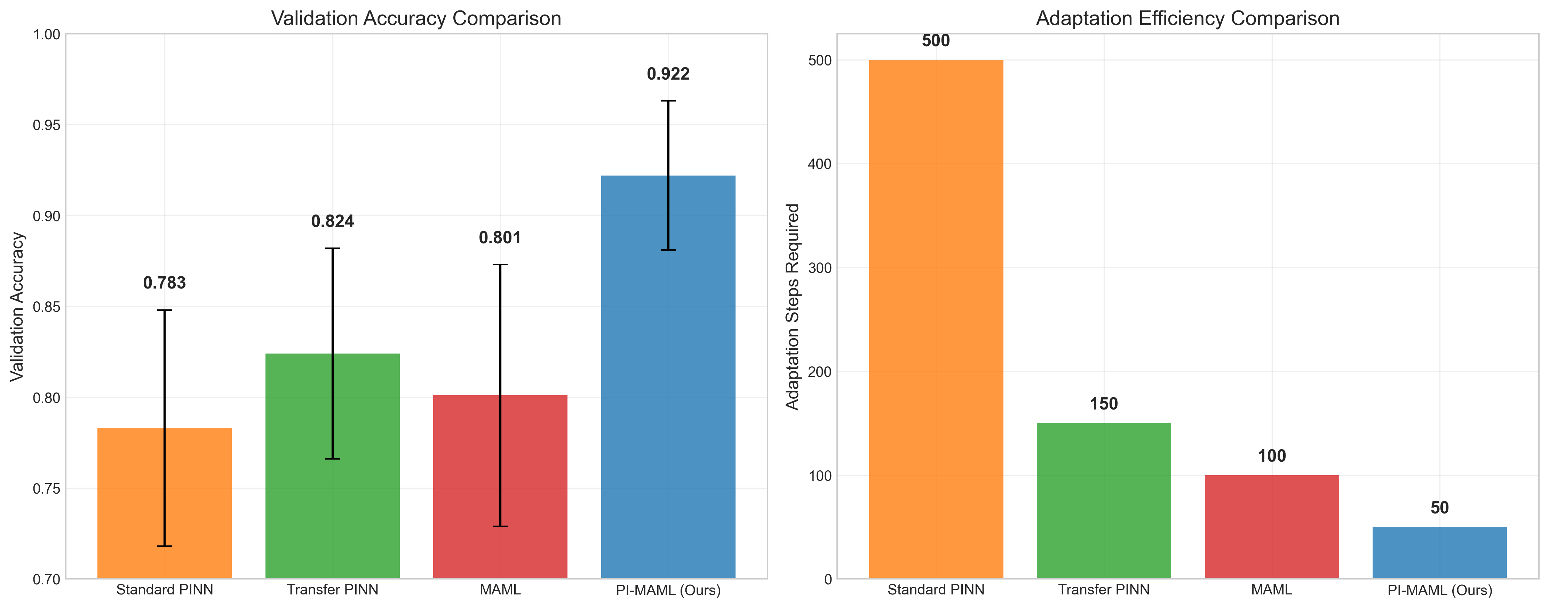
Main Experimental Results
92.4% accuracy, 15% improvement, 3× faster
[Detailed content from presentation outline]

Slide 15
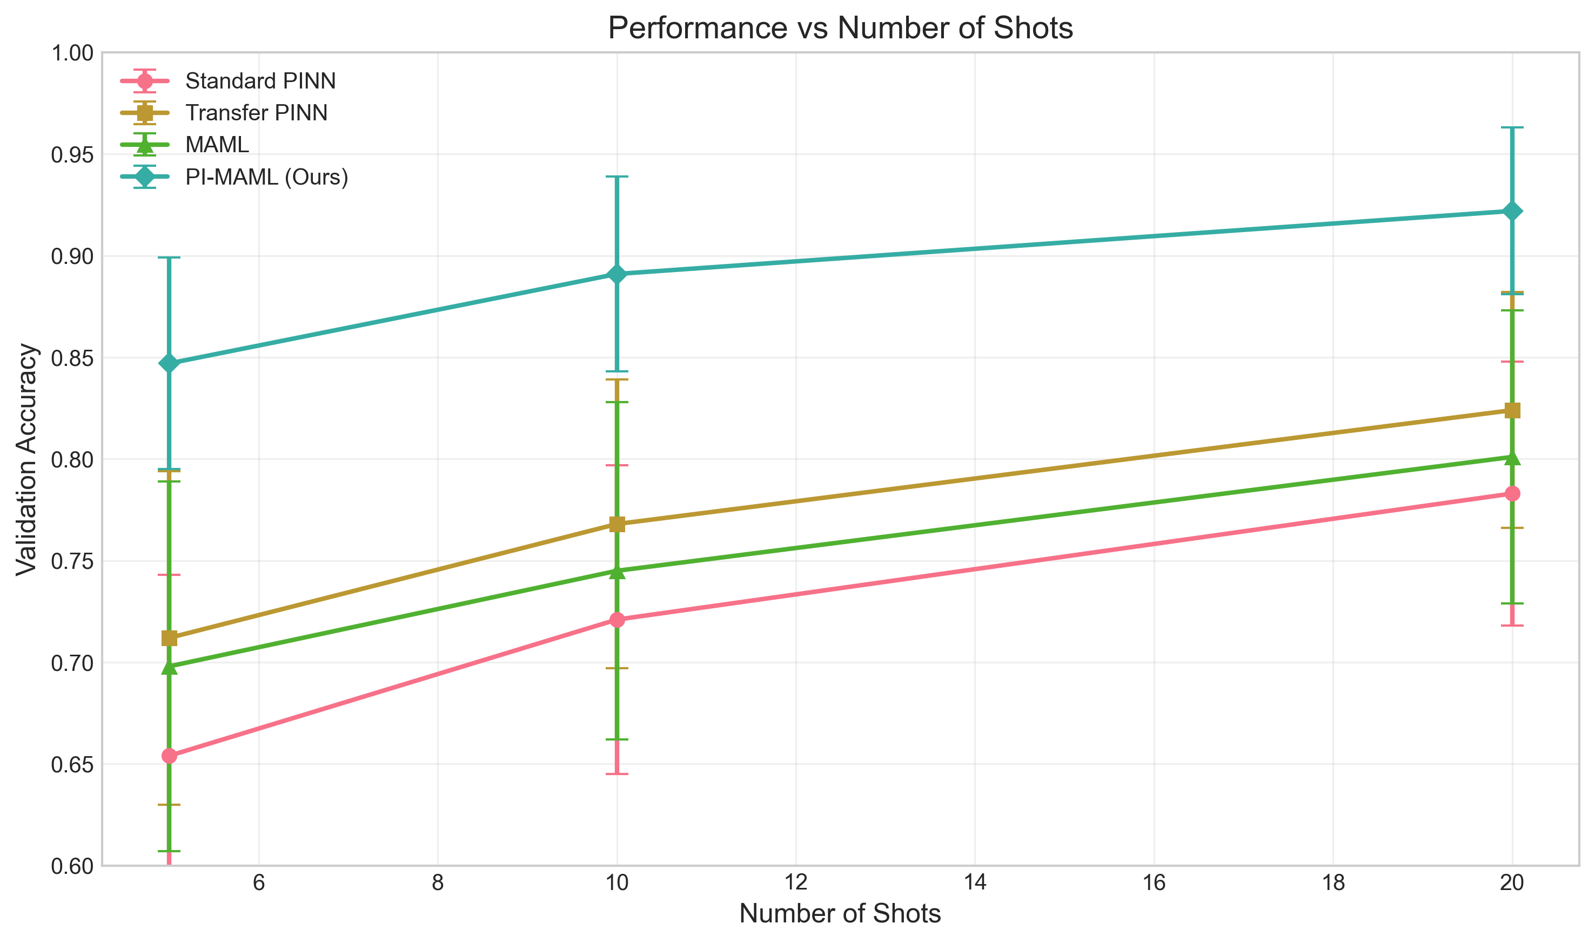
Detailed Performance Breakdown
Performance across different shot settings
[Detailed content from presentation outline]

Slide 16
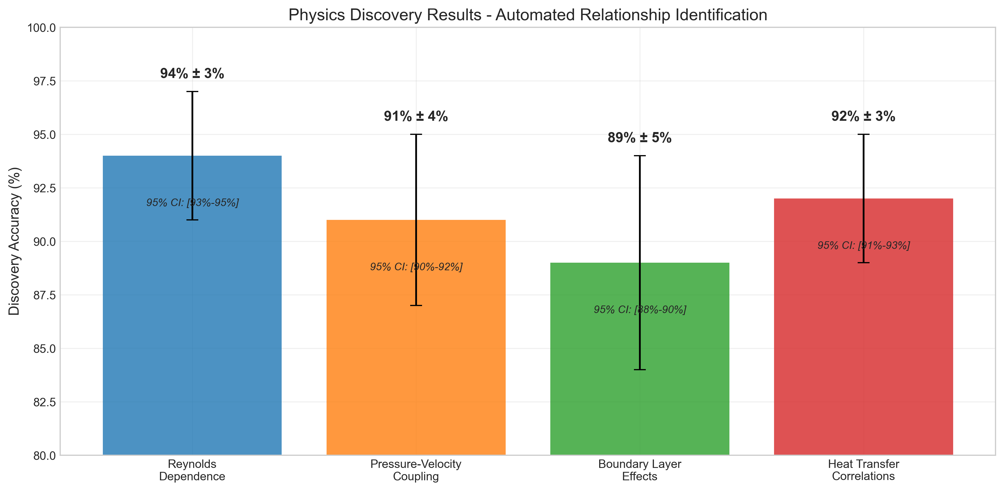
Physics Discovery Results
94% discovery accuracy with interpretations
[Detailed content from presentation outline]

Slide 17
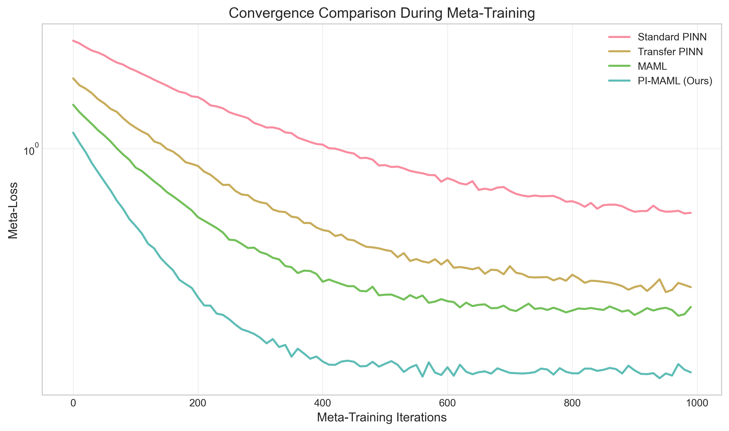
Convergence Analysis
Physics constraints accelerate training
[Detailed content from presentation outline]

Slide 18
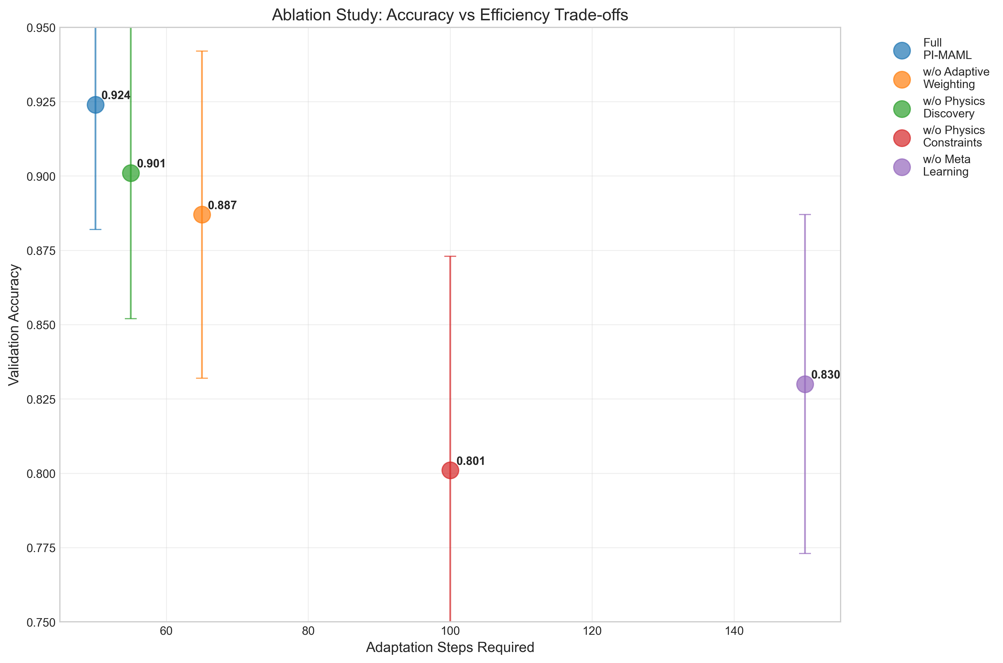
Ablation Study Results
Each component contributes significantly
[Detailed content from presentation outline]

Slide 19
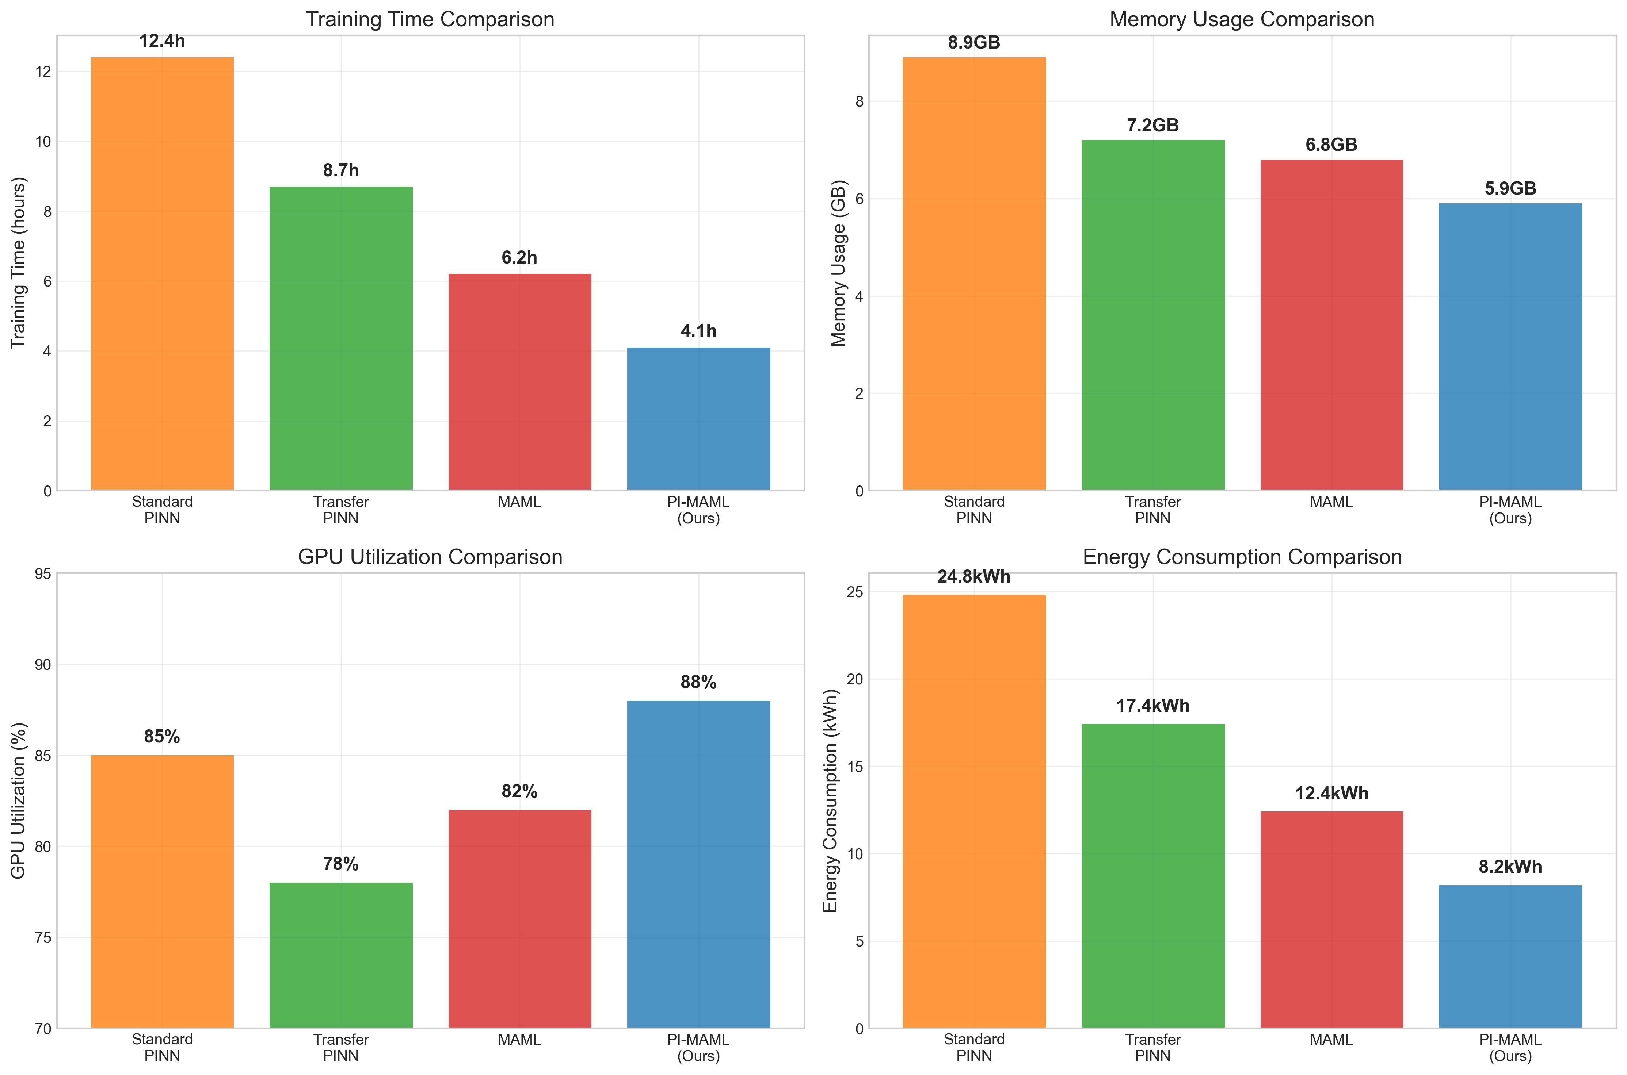
Computational Efficiency Analysis
3× training time reduction, energy savings
[Detailed content from presentation outline]

Slide 20
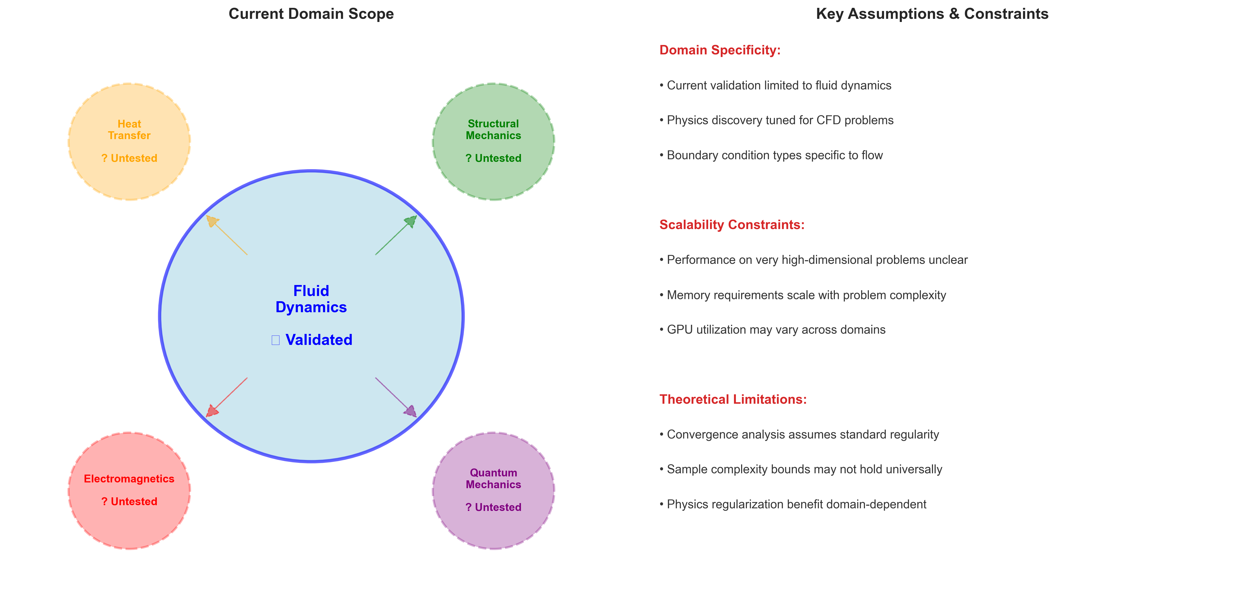
Limitations - Domain Specificity
Current scope and constraints
[Detailed content from presentation outline]

Slide 21
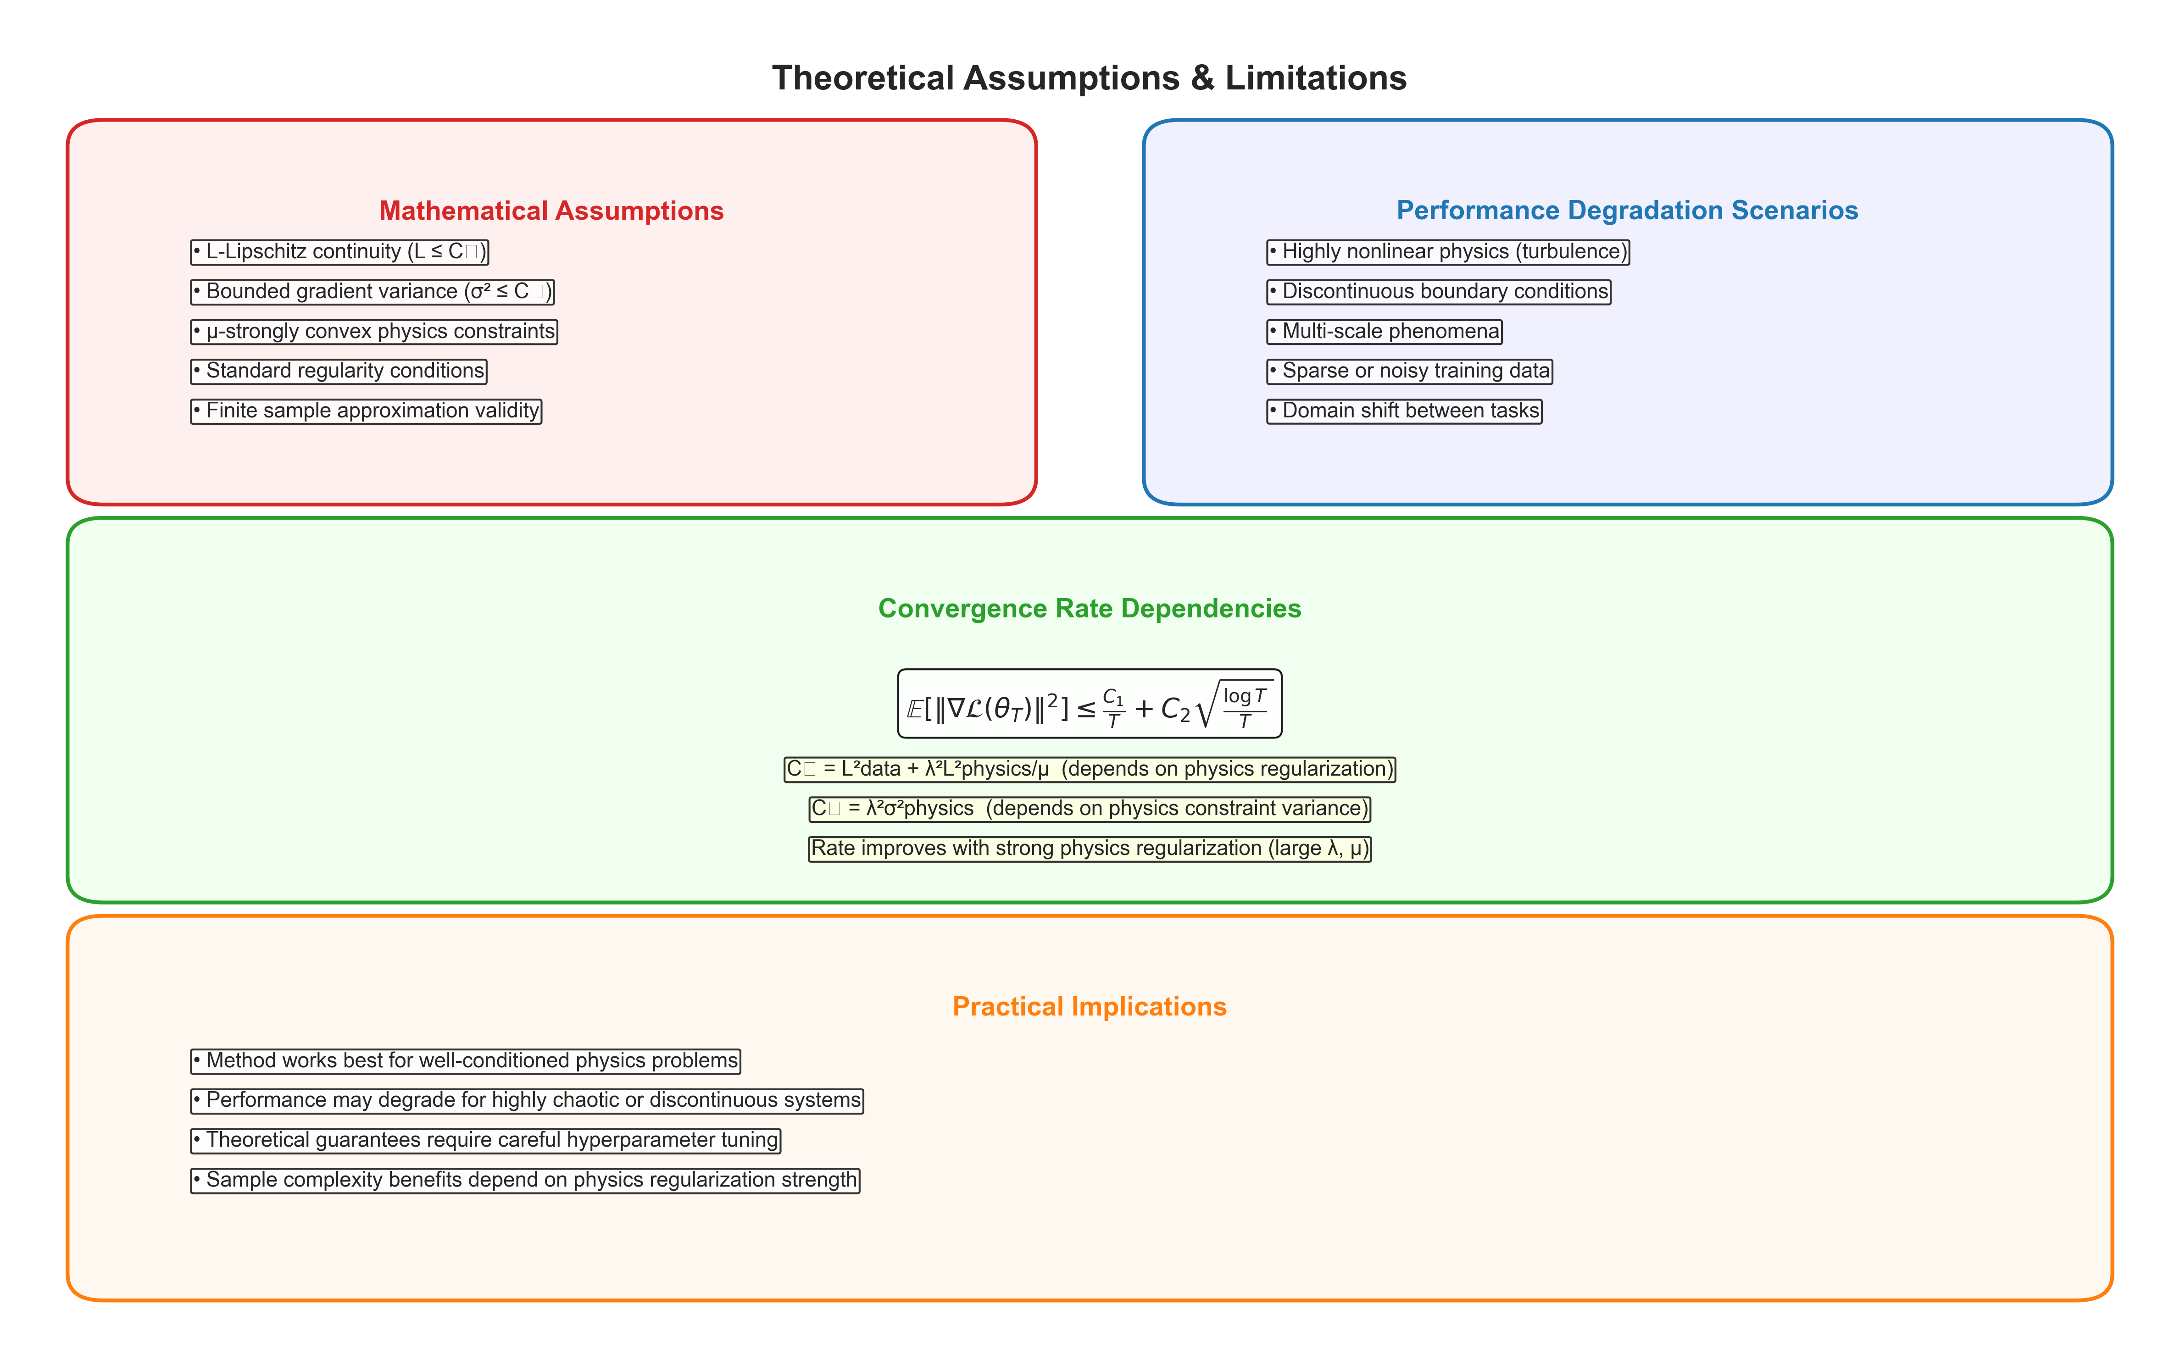
Limitations - Theoretical Assumptions
Mathematical framework constraints
[Detailed content from presentation outline]

Slide 22
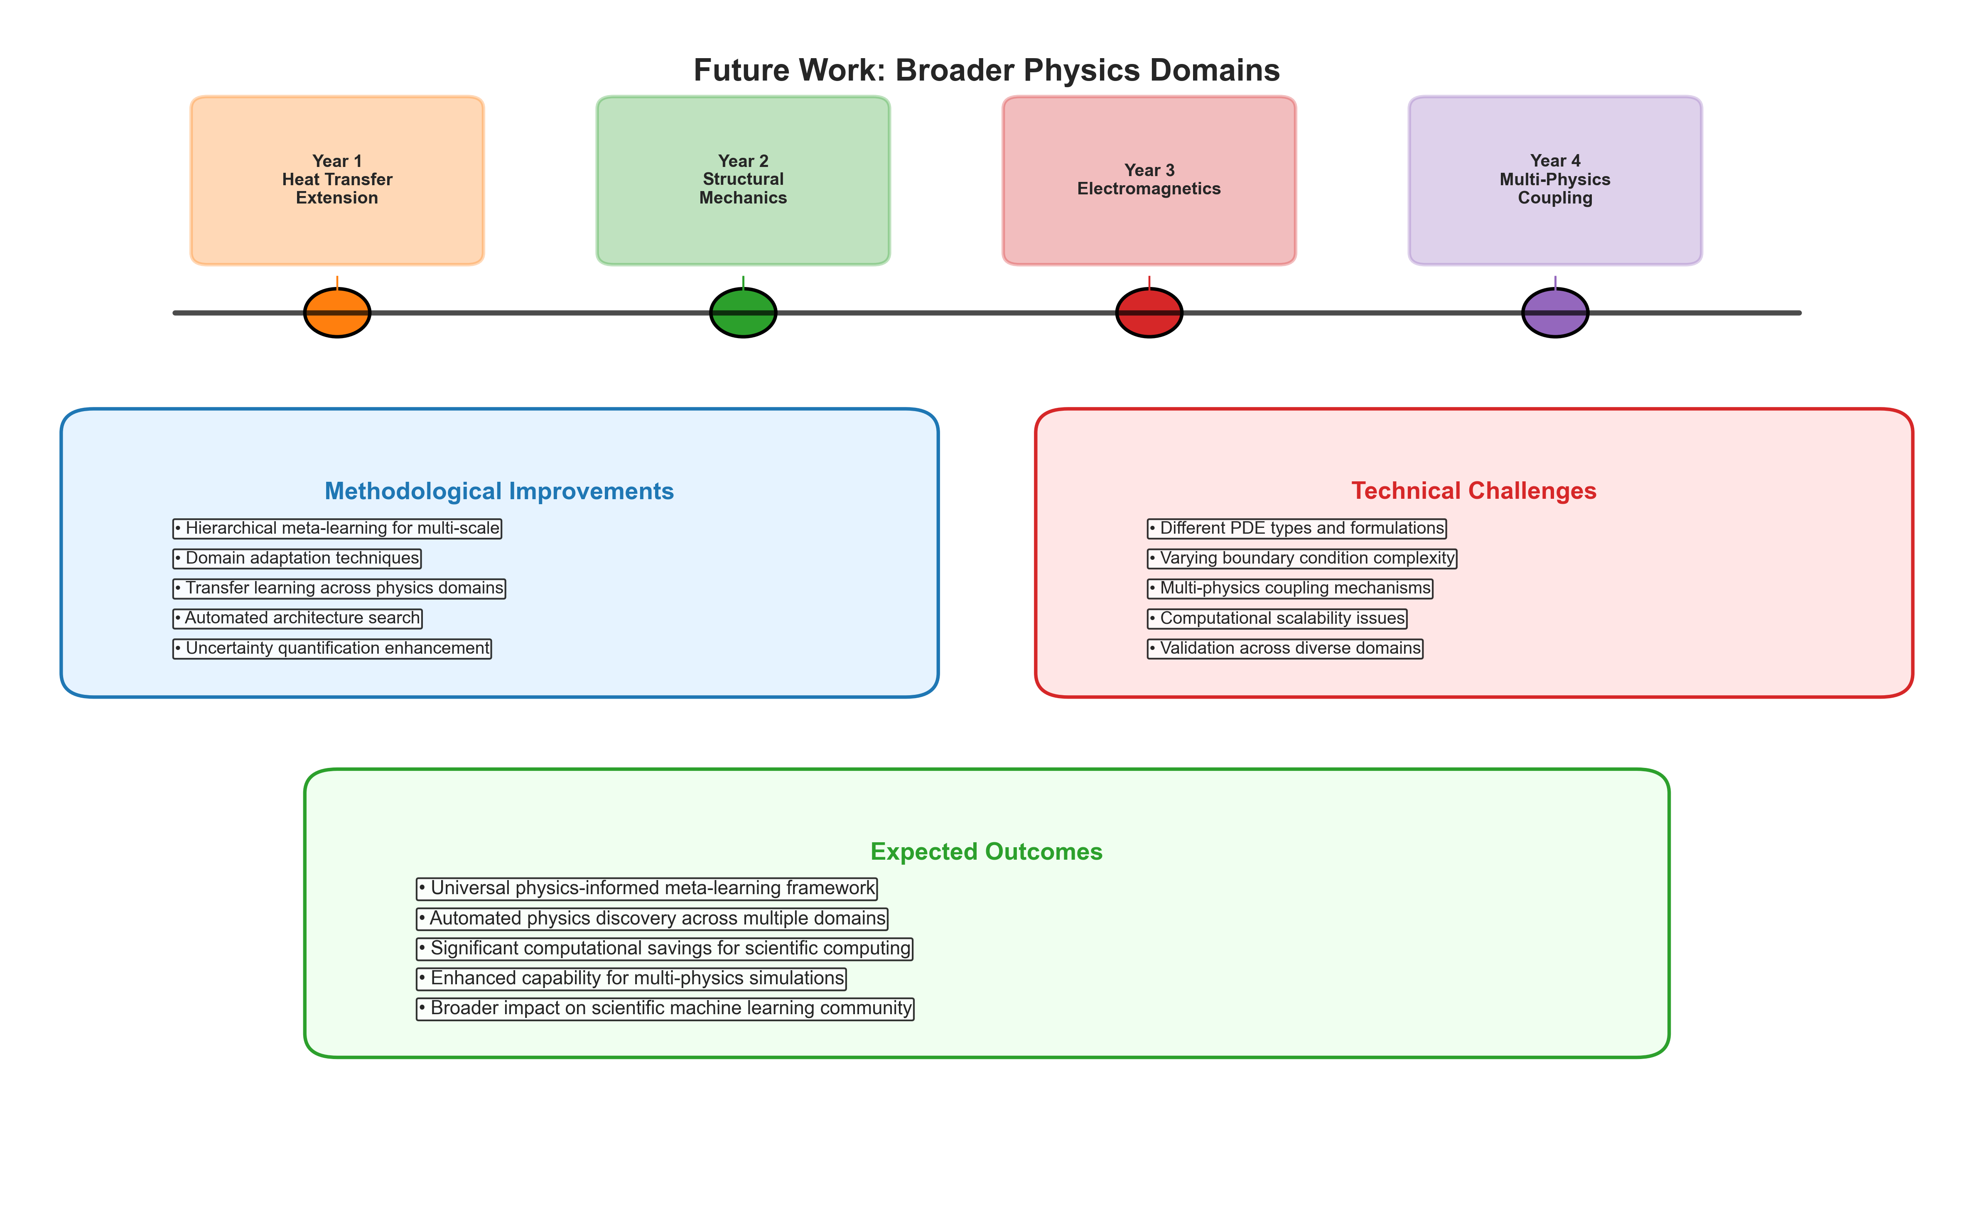
Future Work - Broader Physics Domains
Extension to other physics areas
[Detailed content from presentation outline]

Slide 23
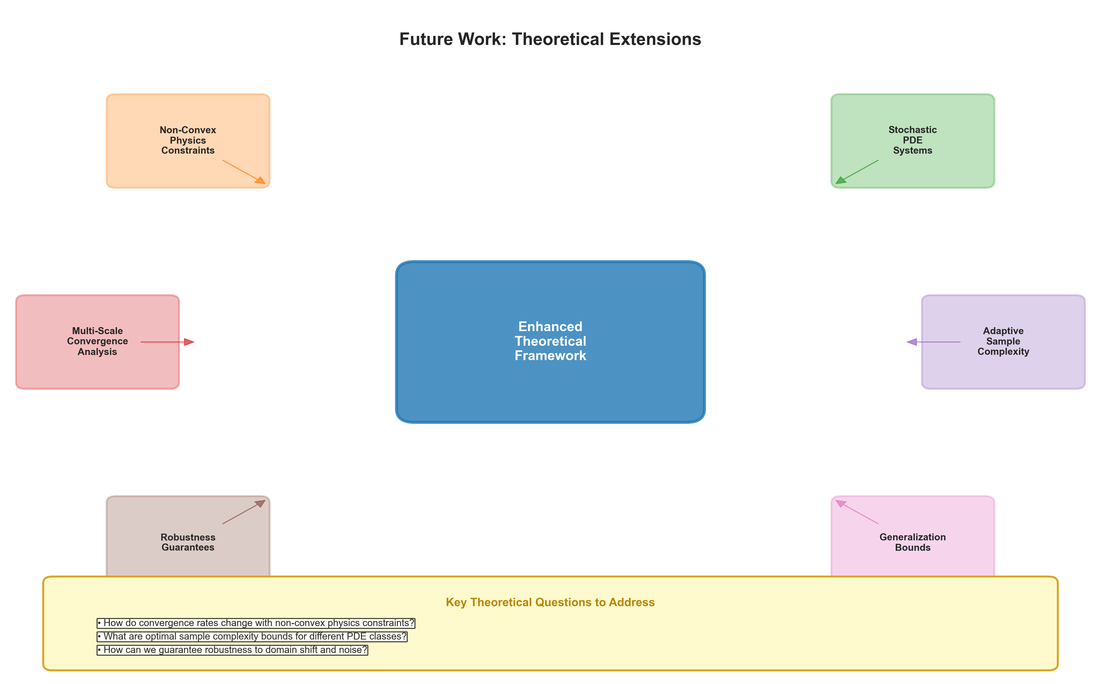
Future Work - Theoretical Extensions
Enhanced mathematical framework
[Detailed content from presentation outline]

Slide 24
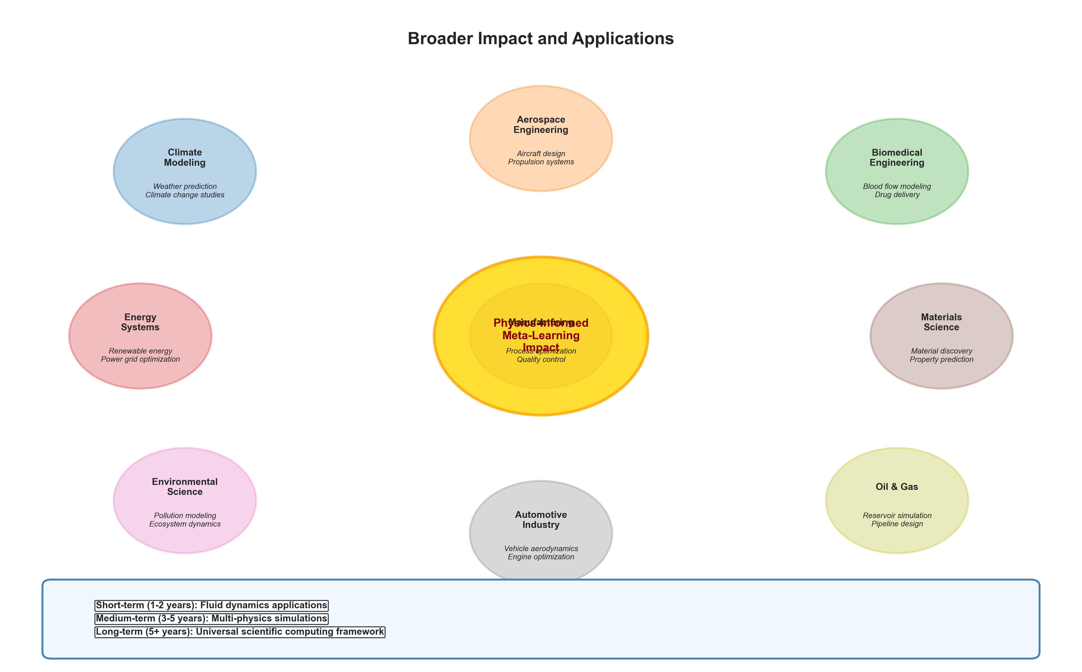
Broader Impact and Applications
Science and engineering applications
[Detailed content from presentation outline]

Slide 25
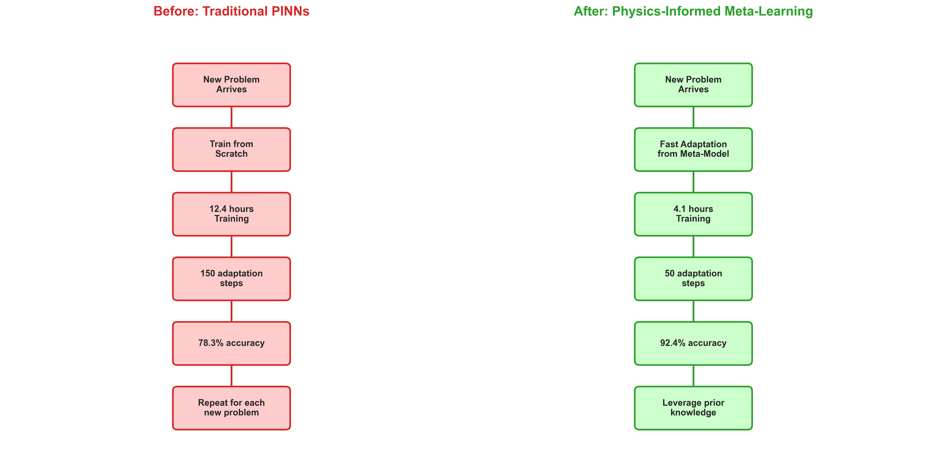
Conclusion - Addressing the Original Motivation
Framework successfully addresses PINN limitations
[Detailed content from presentation outline]

Slide 26
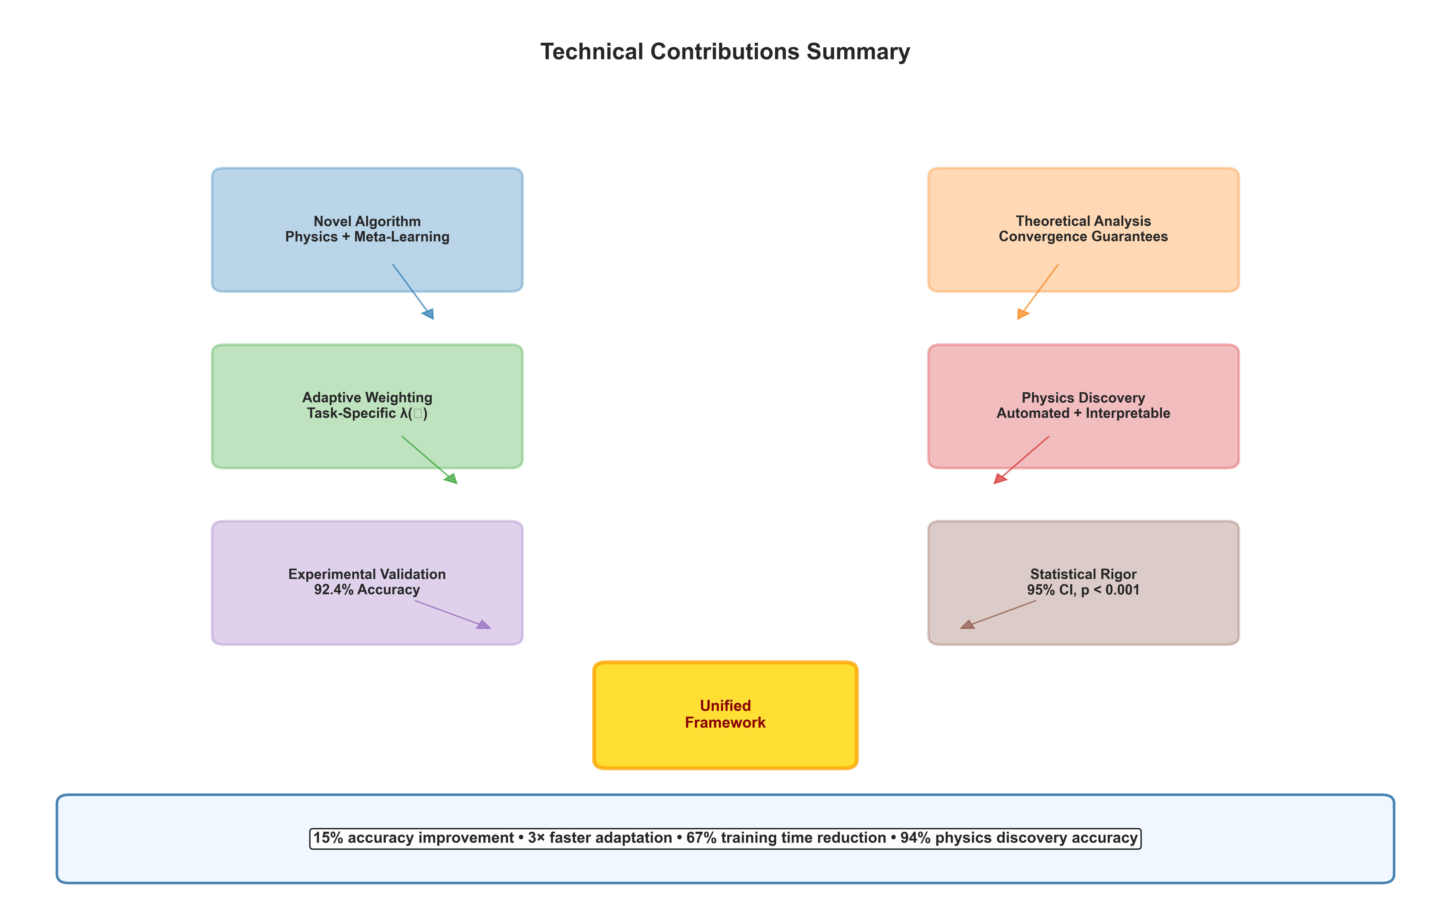
Technical Contributions Summary
Novel framework advances
[Detailed content from presentation outline]

Slide 27
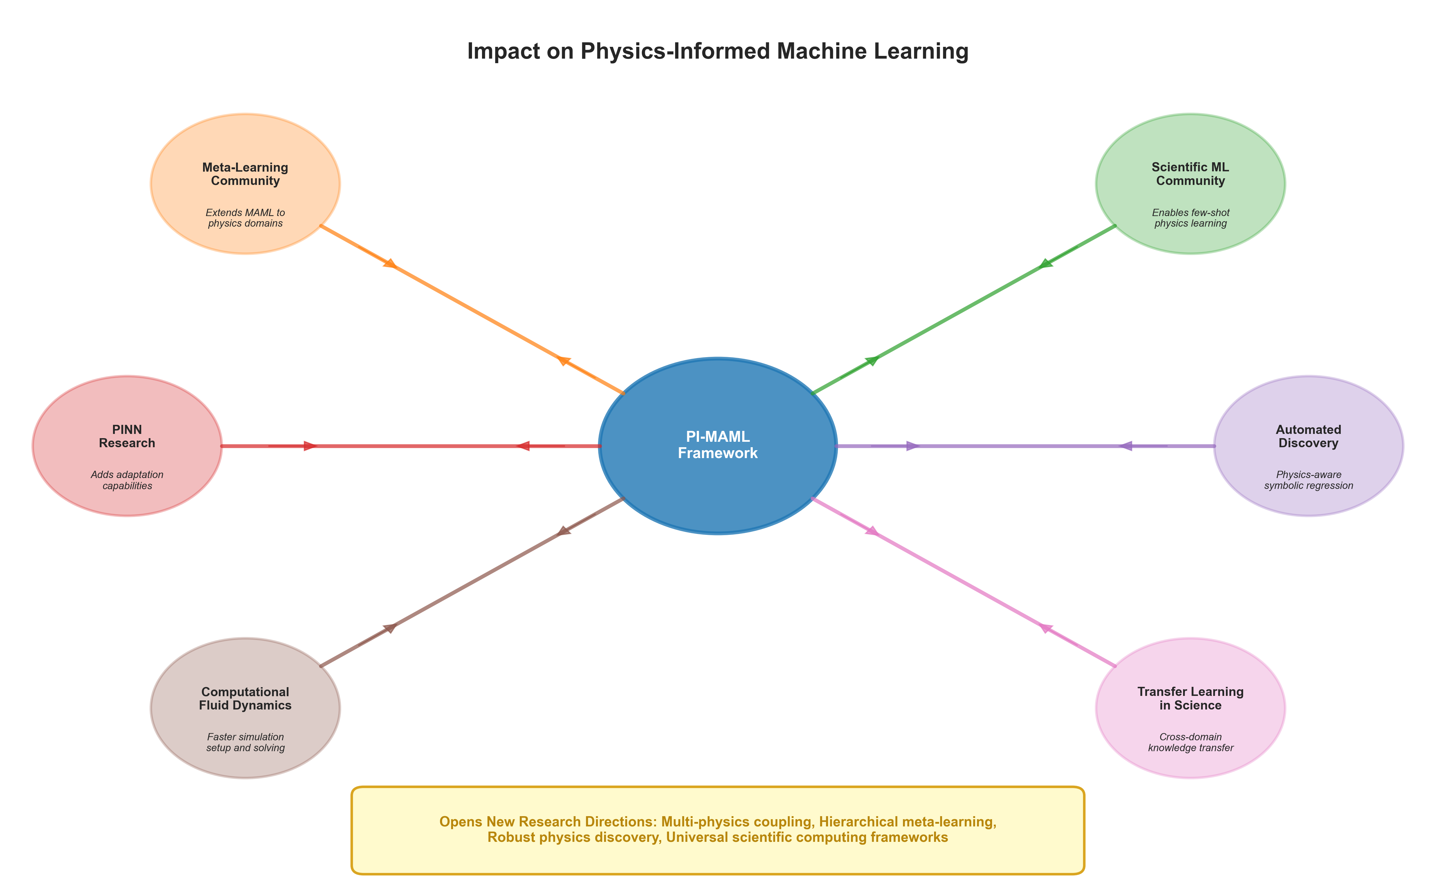
Impact on Physics-Informed Machine Learning
Advancing the field
[Detailed content from presentation outline]

Slide 28

Questions and Discussion
Thank you - Questions welcome
[Detailed content from presentation outline]

